Slide 1
Open Educational Resources nuggets to go
Aurora staff teaching program
Notes:
Main slide:
- There are 2 layered images. To select bottom image and replace it, click on image, select “Picture Format” in ribbon, then “Select(ion) Pane” in “Arrange” tab. Select picture in the column on the right (Picture 4), move or right click, then “Change Picture”

Slide 2
Agenda
Introduction
Benefits
CC-Licences
Search Engines
Notes:
Basic content slide

Slide 3
1
Aurora Universities
OER working group
University of Iceland: Páll Ásgeir Torfason
Vrije Universiteit Amsterdam: Sylvia Moes, GG van de Bunt, Hans Akkermans, Marrij Zeeman
University of East Anglia: Ian Davis, Alicia Mcconnell, Kay Yeoman
University Duisburg-Essen: Anke Petschenka, Aylin Kilic, Marianne Wefelnberg, Daniel Otto, Stephanie Herbstreit
Universität Innsbruck: Ortrun Gröblinger
Universitat Rovira I Virgili: Jordi Duch Gavaldà, John Style, Ana Beatrix Hernandez
Università di Napoli Federico II: Valentina Reda, Bruno Catalanotti, Roberto Delle Donne, Giuseppe De Rosa, Chiara Caiazzo
University of Aberdeen: Kirsty Kiezebrink, Stephen Hill
8
3
2
4
5
6
7

Slide 4
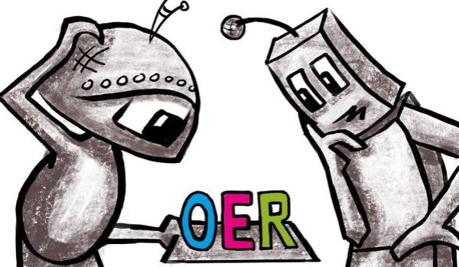
What are OER?
Open Educational Resources (OER) are educational materials of all kinds (e.g. e-books, videos, worksheets, etc.), which are of increasing relevance, especially in the university context.
Educational resources are characterised by the fact that they are freely accessible and are under a free licence. Licenses indicate the use and further distribution of an educational material.
For example, they can be (re)used, modified, republished under a different license.
https://pixabay.com/de/illustrations/roboter-oer-3263267/
Notes:
Basic content slide + presentation boxes variant 1

Slide 5
Benefits

Slide 6
Benefits of Open Educational Resources
OER promotes the Aurora network with a showcase of its members´ pedagogic innovation and talent.
Producing and working with high quality educational material increases the importance of teaching
OER gives students the opportunity to be co-creation partners benefiting themselves and the Aurora network
Re-use of qualitative OER (fragments) saves time and continually improved resources
OER helps making teaching visible (like research)
OER has a clear and simple legal status – it allows free use and re-purposing by others
OER is a cost effective and efficient way to collaboratively create (and improve) high quality resources
OER contributes to providing fair and equal access to knowledge for all
Notes:
Work Package “tree” list

Slide 7
What are the 5 R?
Retain: the right to make, own and control copies of the content (e.g. download, store and reproduce)
Reuse: the right to use the content in different contexts (e.g. in a classroom, in a learning group, on a website, in a video)
Revise: the right to edit, adapt, change or redesign the content (e.g. to translate a content into another language)
Remix: the right to combine an original or edited content with other open content and create something new from it (e.g. when incorporating images and music into a video)
Redistribute: the right to share copies of content with others, in the original or in your own revisions (e.g. give a copy to a colleague or publish it online).
Notes:
Basic content slide + presentation boxes variant 1

Slide 8
Licences – Creative Commons

Slide 9
How do I use OER legally compliant?
OER and the corresponding rights can be recognized by an open license. In most cases this is a Creative Commons (CC) license which is internationally accepted and is an alternative to the ubiquitous regulation to reserve all rights, which strongly limits the further use of educational materials.
Materials that are marked with a CC license may generally be reproduced, used and distributed. The description of the respective license indicates the terms of use:
More information about CC licenses: https://creativecommons.org/licenses/?lang=en
Notes:
Basic content slide + presentation boxes variant 1

Slide 10
How does the licensing model work?
Attribution (BY)
The author, the source and any changes made must always be indicated.
Share Alike (SA)
Attribution of the author and dissemination under the same conditions.
Non-Commerical (NC)
Attribution, non-commercial use only.
No Derivatives (ND)
Attribution, no adaption or modification allowed.

Slide 11
CC BY NC SA
Attribution, NonCommercial, ShareAlike.
CC BY NC ND
Attribution, NonCommercial, NoDerivs.
CC 0
Material can be used without restrictions.
CC Public Domain
Material without copywrite (worldwide).

Slide 12
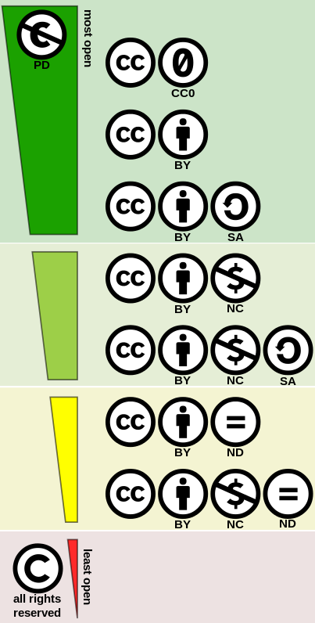
Openess of Creative-Commons Licences
What is not forbidden is allowed
No geographical limitation
The time limit is based on the applicable copyright law
No change from “more open” licenses to more restrictive ones
Unintentional legal violations can occur
CC BY 4.0 Shaddim, Creative Commons license spectrum, URL: https://commons.wikimedia.org/wiki/File:Creative_commons_license_spectrum.svg, picture cropped

Slide 13
Search Engines – OER Portals (Hubs)

Slide 14
OER portal – Austria
https://www.openeducation.at/ OER Hub not open jet – (planned for 04/2022: https://www.openeducation.at/suchen/)
Uni Innsbruck: Coming soon: https://www.uibk.ac.at/oer/
Uni Wien: https://phaidra.univie.ac.at/
Technical University Graz, University Graz: OER-Repo coming soon.
MOOCs: https://imoox.at/mooc/
! Policies for OER (HEIs)
Notes:
Basic content slide + presentation boxes variant 1

Slide 15
OER portal – Germany
Due to the situation in Germany – we have 16 federal states - we have several OER-repositories…
Since September 2021, we have one for the federal state north rhine Westphalia, Open Resources Campus (ORCA.nrw): https://www.orca.nrw/.
At the University Duisburg-Essen (UDE) we have a local repository which will be connected to the landwide-one (in progress). OER-repository: https://duepublico2.uni-due.de/content/index.xml;jsessionid=0C55A44A8431452BE66E56217F365421?lang=en.
Further information on Open Educational Resources provided by the university library: https://www.uni-due.de/ub/en/eoer.php
Further projects: OER policy & staff training & funding project (2022)
Notes:
Basic content slide + presentation boxes variant 1

Slide 16
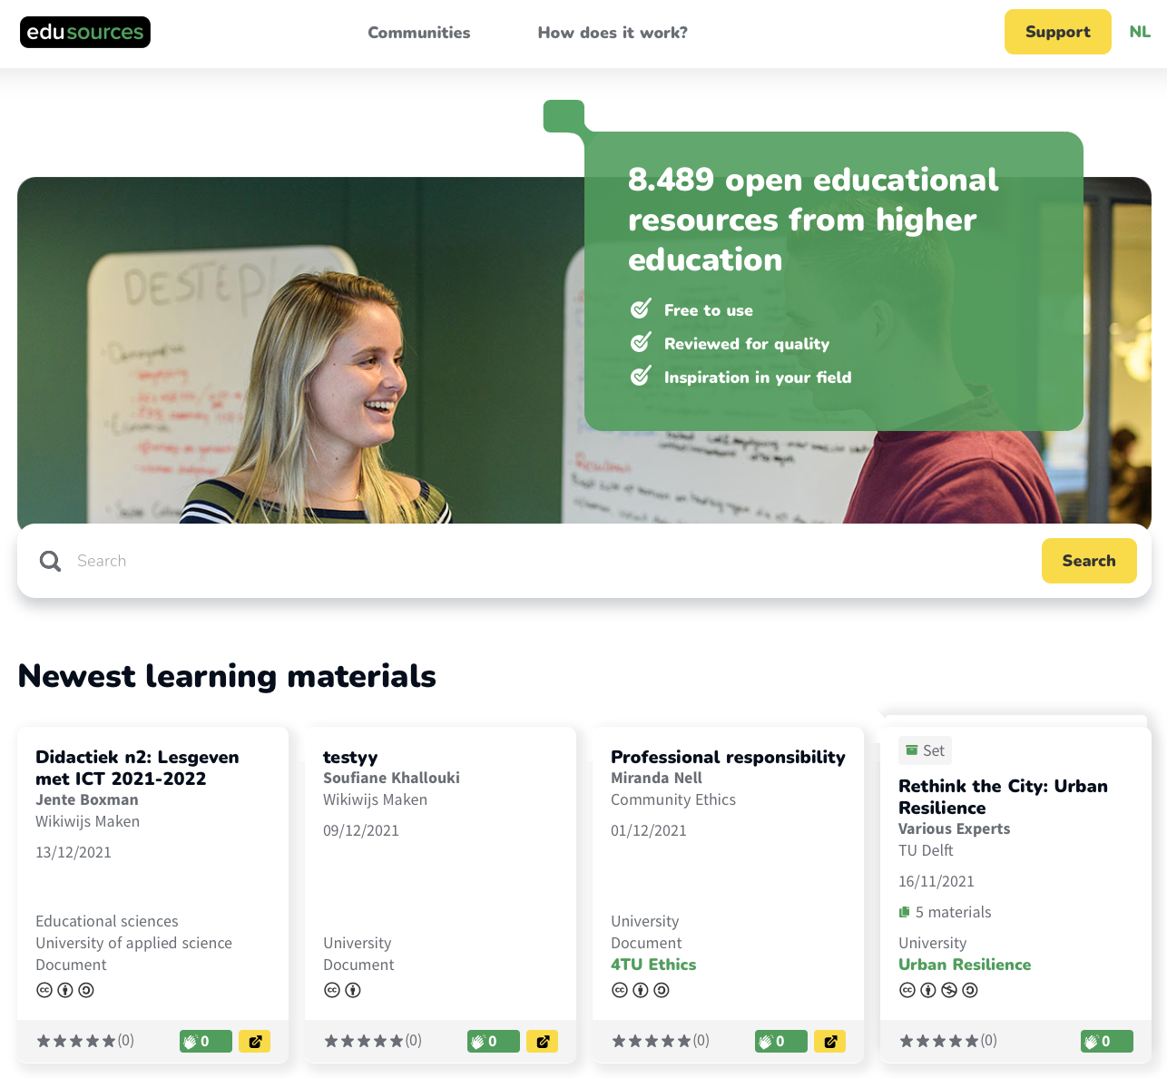
OER portal – The Netherlands
Notes:
Basic content slide + presentation boxes variant 1

Slide 17
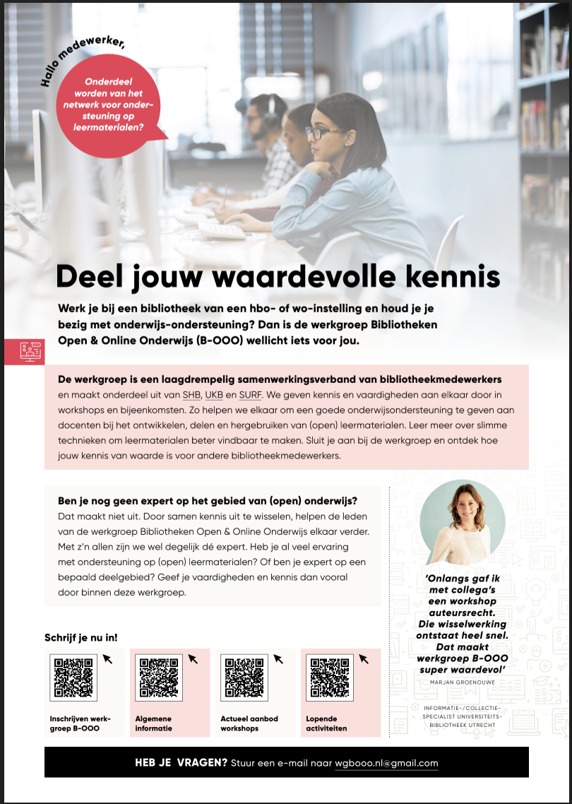
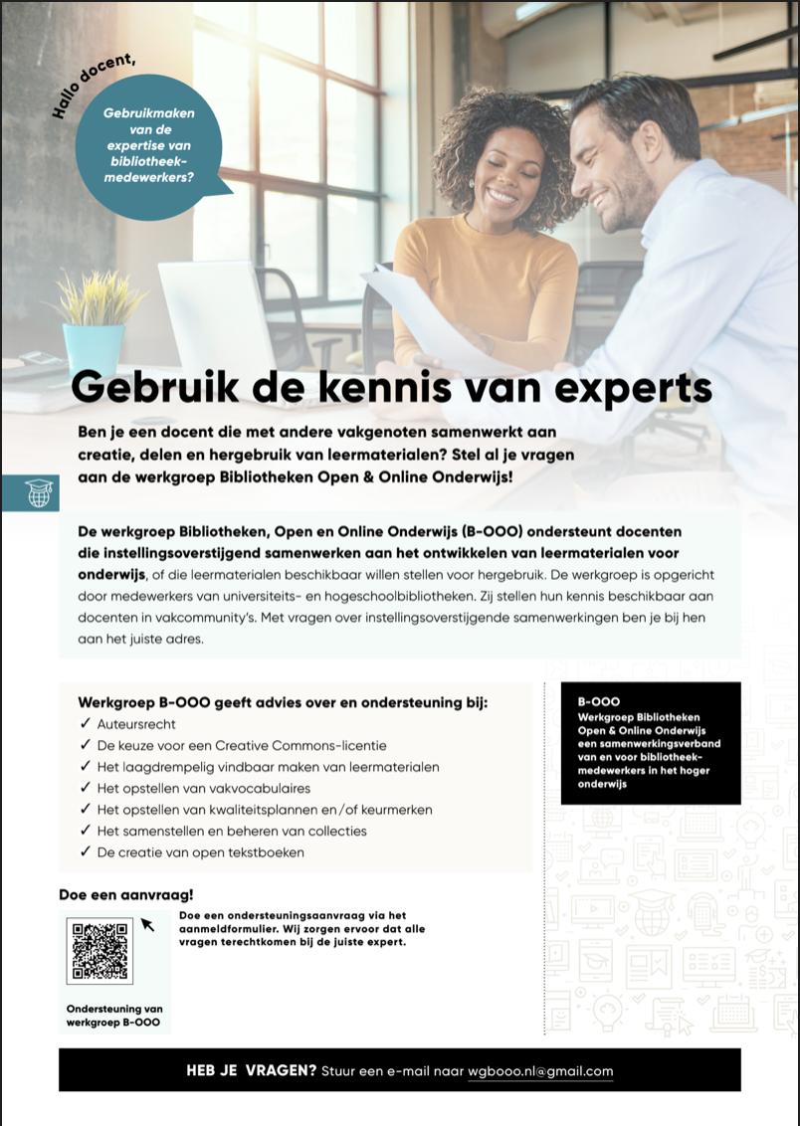
Scaling up
National project running for 2 years (2021-2022), helping 30 HE instutions to share materials
Workshops for librarians to help support teachers and teacher communities to discloser OER
https://sites.google.com/vu.nl/biebooo/homepage

Slide 18
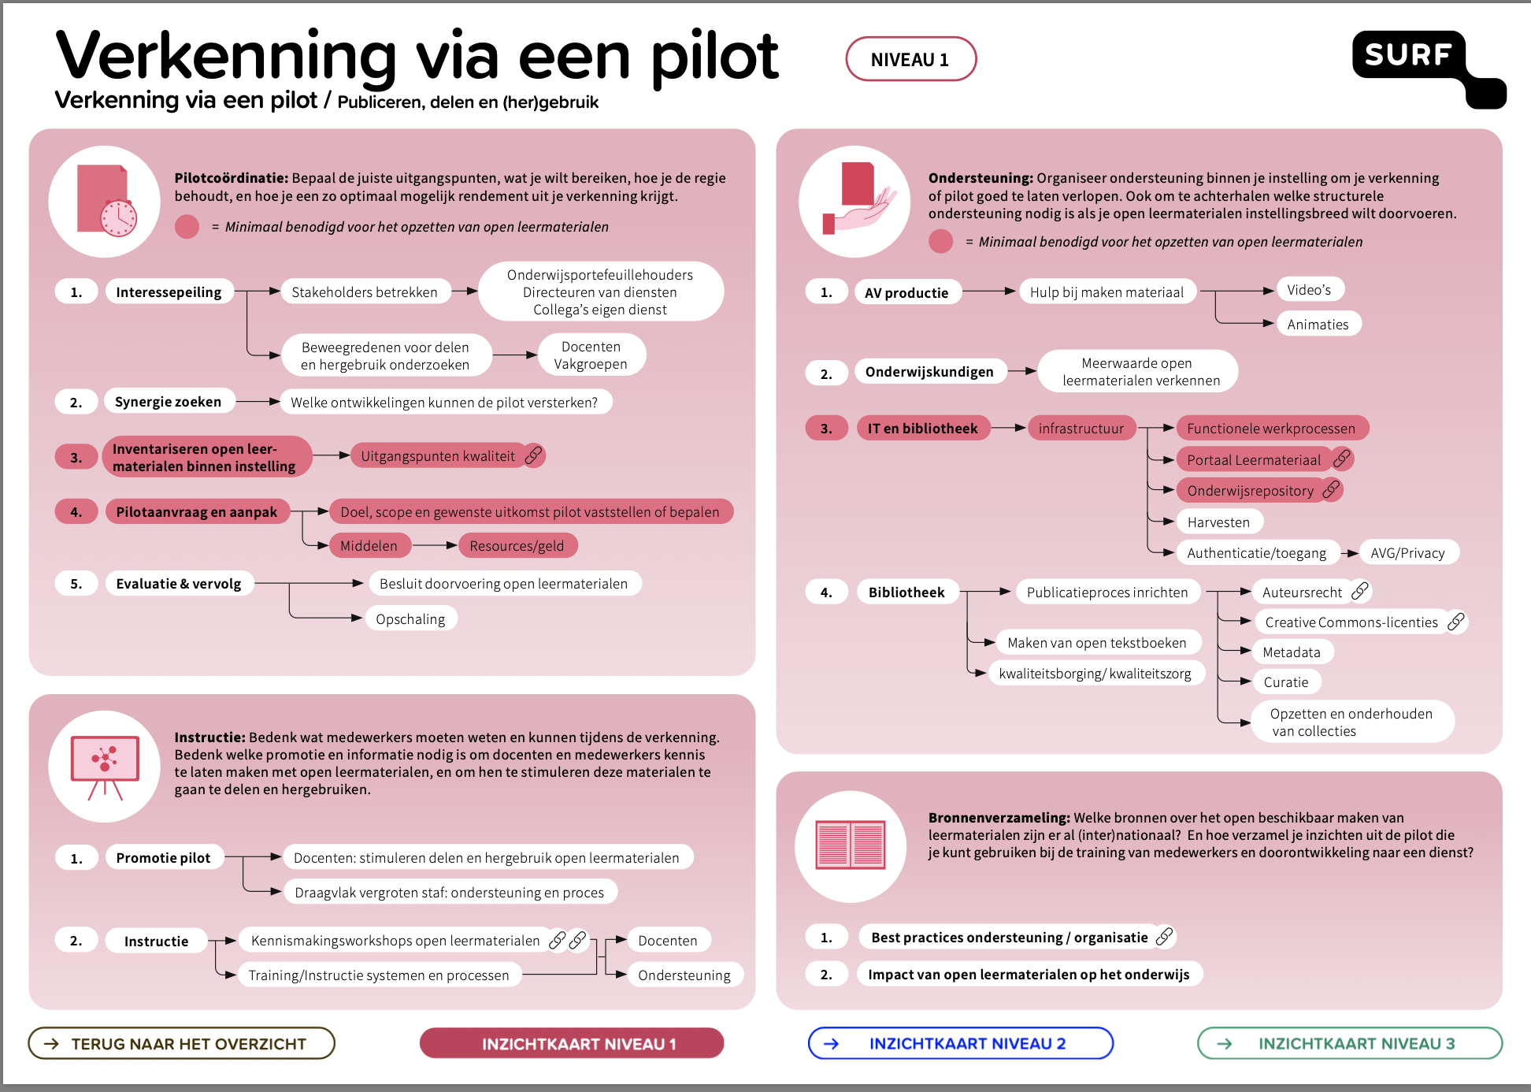
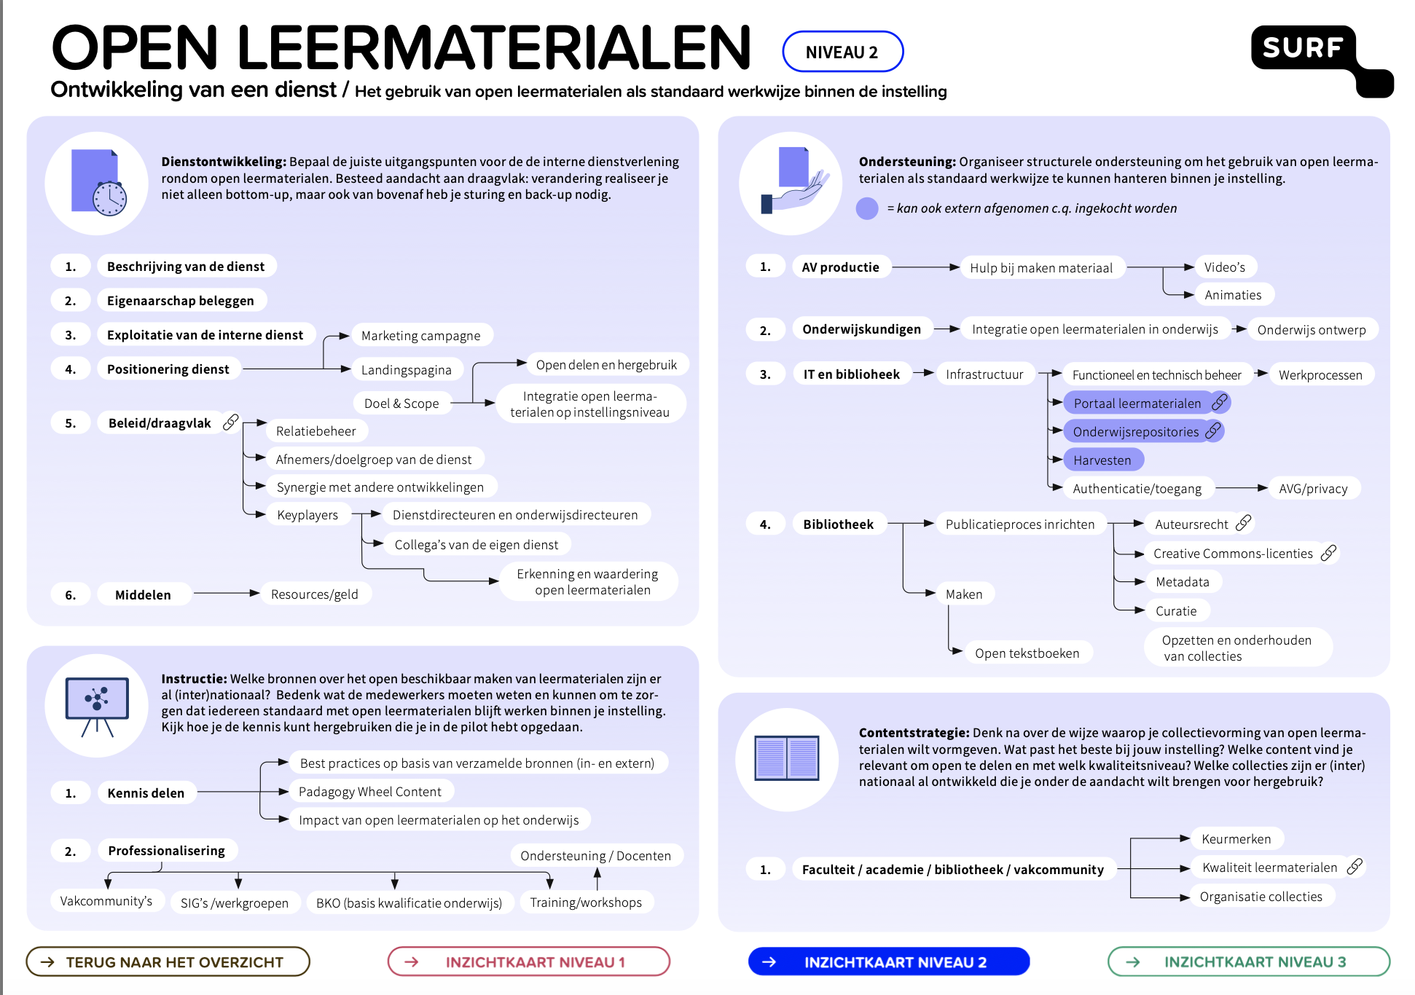
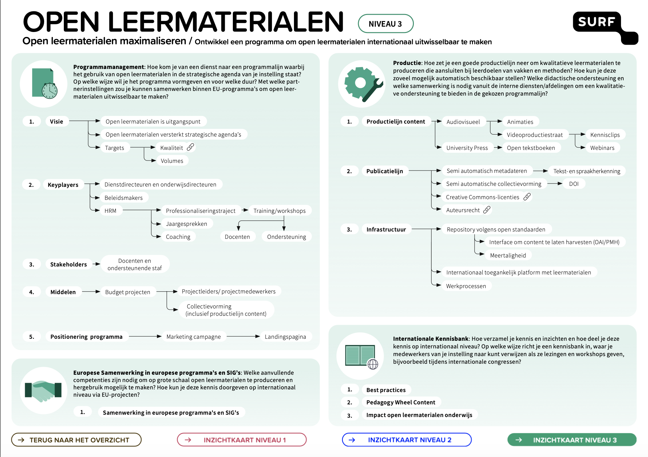
Tools
https://www.surf.nl/files/2021-07/infographic-open-leermaterialen-organiseren_def.pdf

Slide 19
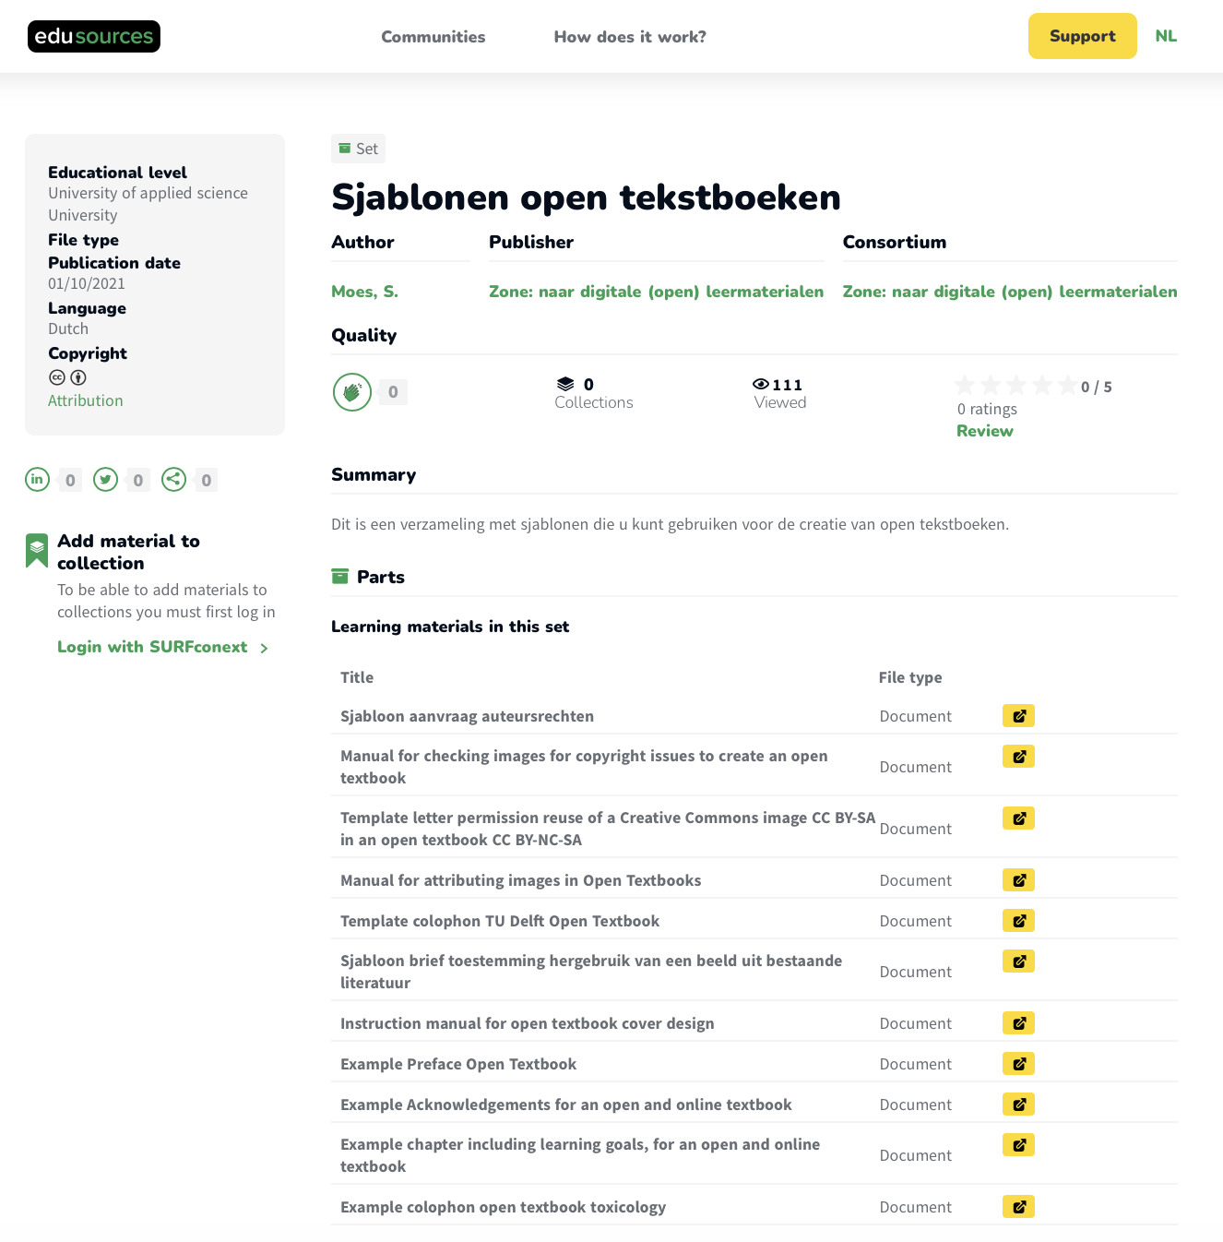
Tools: creation of Open textbooks
Online tool to create open textbooks
Templates in edusources

Slide 20
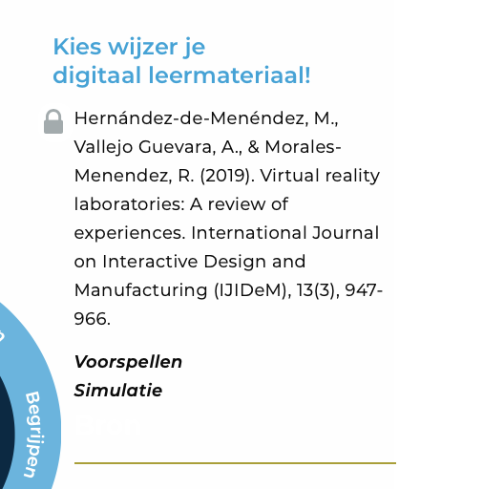
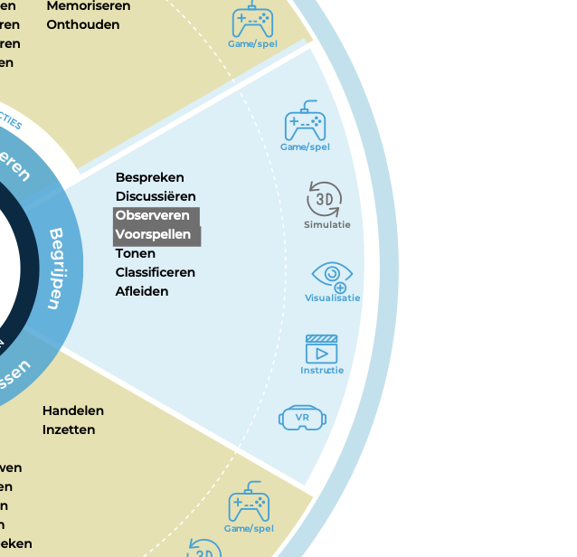
Tools: types of content related to learning activities and goals
https://www.versnellingsplan.nl/Kennisbank/tool-kies-wijzer-digitaal-leermateriaal/

Slide 21
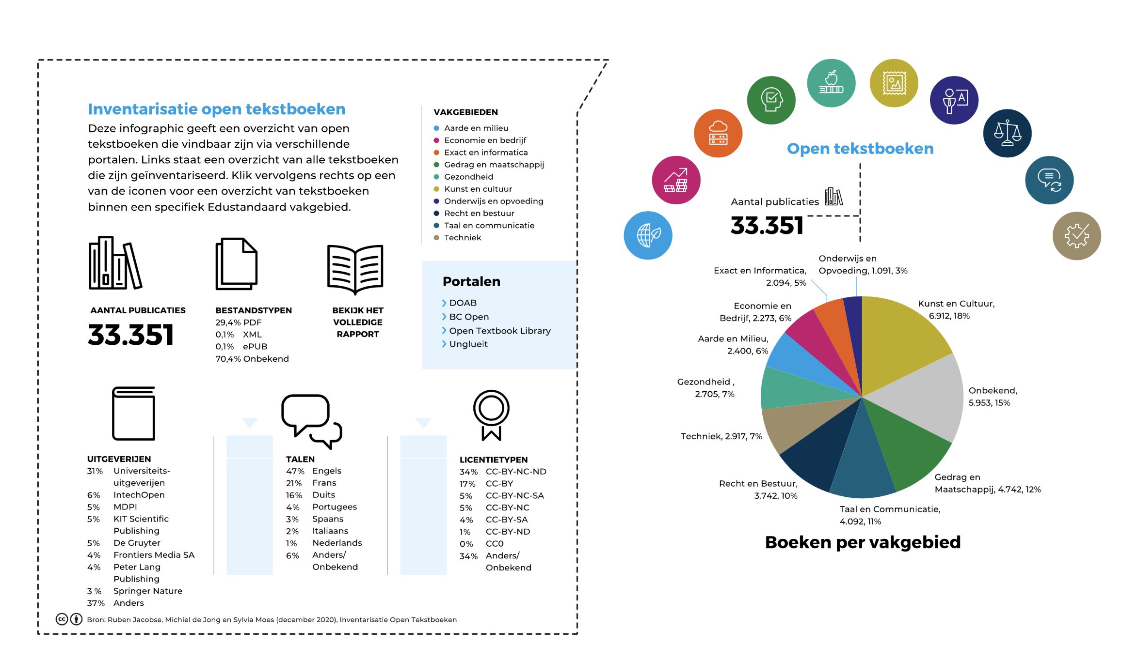
Tools: interactive infographic open textbooks
https://www.versnellingsplan.nl/wp-content/uploads/OpenTekstboeken/OpenTekstboeken.html

Slide 22
Search Engine - Showcase Merlot https://www.merlot.org/merlot/index.htm

Slide 23
OER world map
https://oerworldmap.org
Notes:
Basic content slide + presentation boxes variant 1

Slide 24
Next workshops: December 21 – March 22
Open Pedagogy and OER
Creation Processes: How to produce free content? How to produce reusable open content? How to re-mix different resources and how can OER be part of it?
Best Practices: Scenarios from Aurora universities. Scenarios from Aurora universities. Students as co-creation and content owners
List of Things
Notes:
Basic content slide

Slide 25
Questions?
Anke Petschenka anke.petschenka@uni-due.de
Ortrun Gröblinger Ortrun.groeblinger@uibk.ac.at
Sylvia Moes s.moes@vu.nl
Thank you for Listening!
List of Things
Notes:
Basic content slide

