Slide 1
Introduction to Learner Analytics Key Concepts 24/11/21

Slide 2
The aim of this session :
Learner Analytics is a developing area for universities – but it is not always clear what is meant by the term. This session will cover key aspects such as skills needed, technology required, the data that may be used, as well as practical implementation and ethical issues.
The purpose of this event is to give those working in a university environment an understanding of the main aspects, challenges and benefits of a Learner Analytics project. It will also aim to facilitate networking between those interested in this area.
A big question: Individual projects in each institution or a trans-national effort?

Slide 3
Session outcomes:
Gain an understanding of core components of a Learner Analytics initiative:
Data issues.
Descriptive dashboards
Predictive models
Using the outcomes
Skills and Tech
GDPR, Ethics and Digital Citizenship
Co-create an example of a Learner Analytics project will other delegates.
Network with other professionals interested in this area.

Slide 4
Programme for today:
Introduction to Key Concepts
UEA as an example
Skills and Technology
GDPR and Ethics (group discussion)
Group work
Bringing it back together

Slide 5
Key aspects of Learner Analytics:
Architecture – what are you trying to achieve?
GDPR – opt in, or object?
Comparative or internal?
Data: calculated KPIs or ‘grey data’?
Predictive or descriptive?
Links to process
Visible to students?
Measures of success

Slide 6
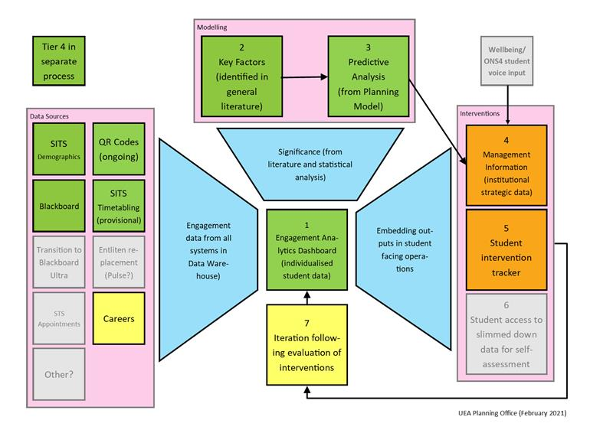
A learning analytics architecture example:

Slide 7
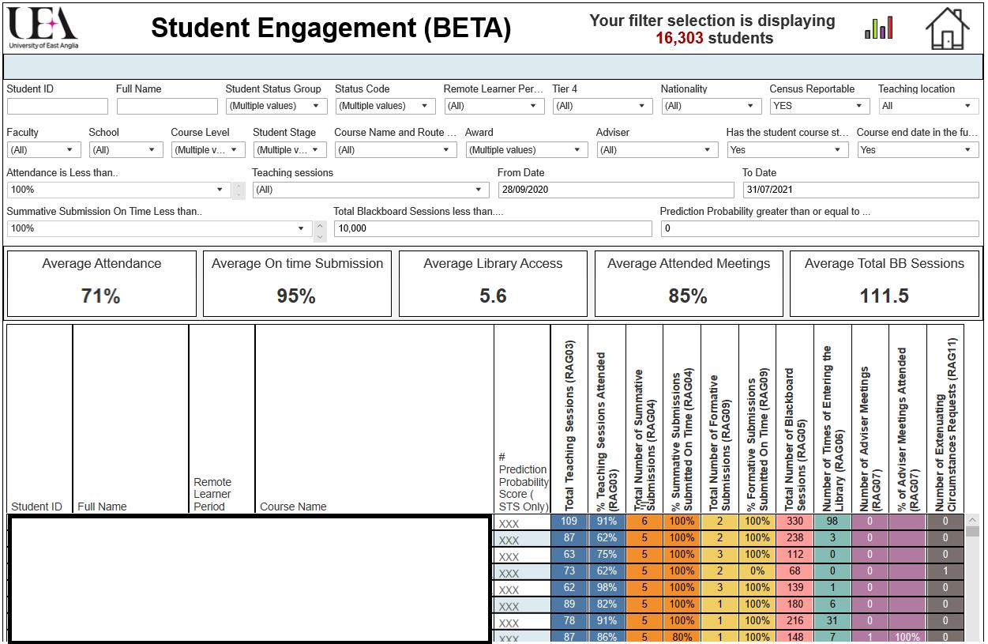
Descriptive statistics:

Slide 8
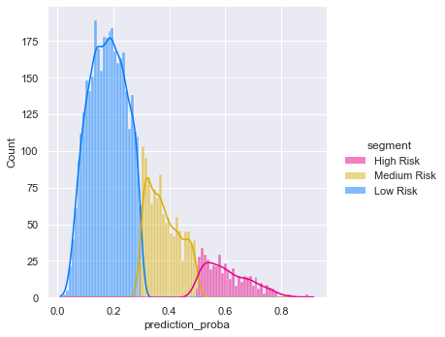
Predictive statistics:

Slide 9
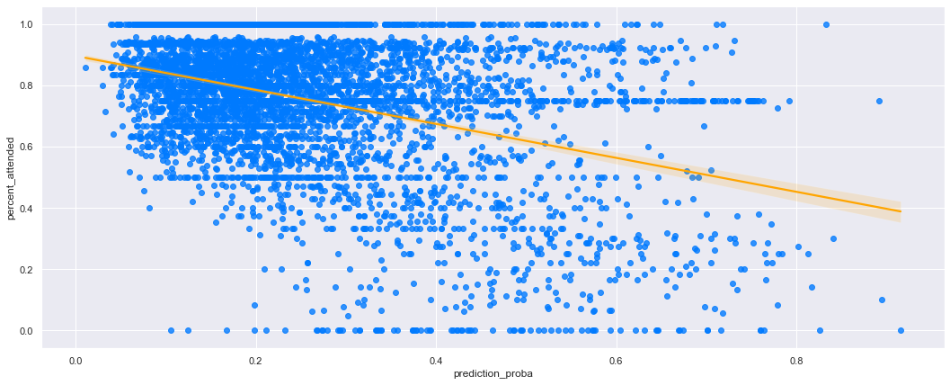
KPIs 1: Identifying variables

Slide 10
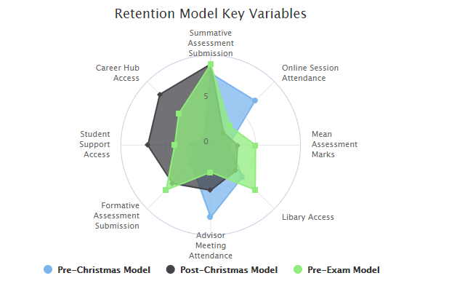
KPIs 2: Shifting variables

Slide 11
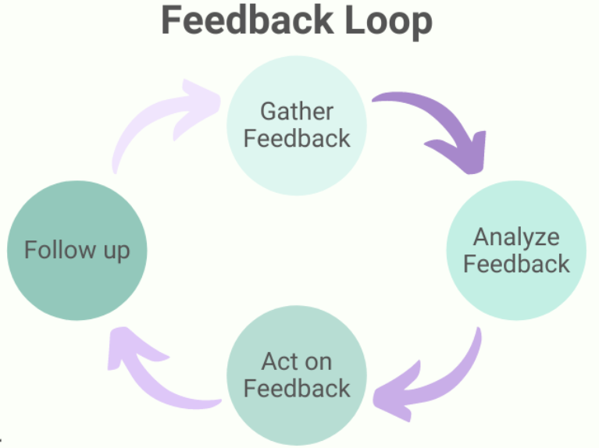
Case Management Feedback Loop

Slide 12
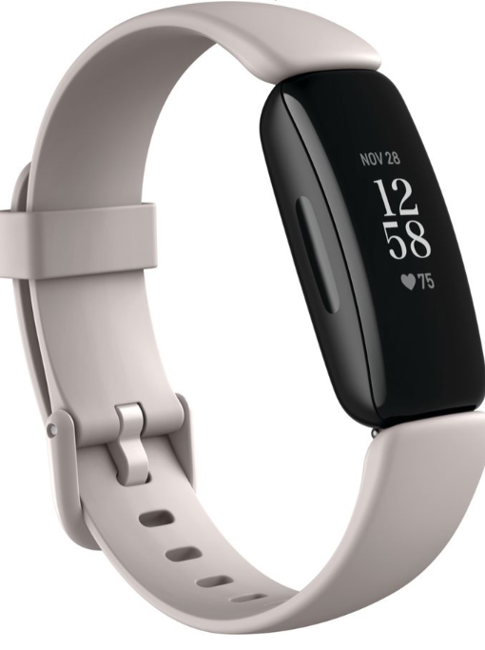
Fitbit for students…
Should a student see data and if, so why? What are we looking to achieve?
What are the risks?
What are the benefits?

Slide 13
Practical Concerns: Skills, Tech and Process
Project Management
Process Review
Testing
Coding language
What model?
How is code stored?
How is code run?
How are the results disseminated?
How do you ensure operational robustness?
Change Control

Slide 14
Ethics and GDPR
Group discussion.

Slide 15
Five minute break
We made it half way!

Slide 16
Group work. Some questions to think about:
What do YOU want to achieve with analytics?
What data do you have available?
How will you disseminate results?
What processes will it impact on?
What problems might there be?

Slide 17
Plenary session:
Welcome Back!

Slide 18
Finishing off:
Final questions/discussion points.
Please contact me at g.fincham@uea.ac.uk if you have any more questions.

