Slide 1



Perspectives on
OER
from
teachers
and
students
Notes:
Main slide:
- There are 2 layered images. To select bottom image and replace it, click on image, select “Picture Format” in ribbon, then “Select(ion) Pane” in “Arrange” tab. Select picture in the column on the right (Picture 4), move or right click, then “Change Picture”

Slide 2


Agenda
Introduction & Benefits
How to manage
Perspectives from teachers
Perspectives from students
Notes:
Basic content slide

Slide 3
1
Aurora Universities
OER working group
University of Iceland: Páll Ásgeir Torfason
Vrije Universiteit Amsterdam: Sylvia Moes, GG van de Bunt, Hans Akkermans, Marrij Zeeman
University of East Anglia: Ian Davis, Alicia Mcconnell, Kay Yeoman
University Duisburg-Essen: Anke Petschenka, Aylin Kilic, Marianne Wefelnberg, Daniel Otto, Stephanie Herbstreit
Universität Innsbruck: Ortrun Gröblinger
Universitat Rovira I Virgili: Jordi Duch Gavaldà, John Style, Ana Beatrix Hernandez
Università di Napoli Federico II: Valentina Reda, Bruno Catalanotti, Roberto Delle Donne, Giuseppe De Rosa, Chiara Caiazzo
University of Aberdeen: Kirsty Kiezebrink, Stephen Hill
8
3
2
4
5
6
7

Slide 4

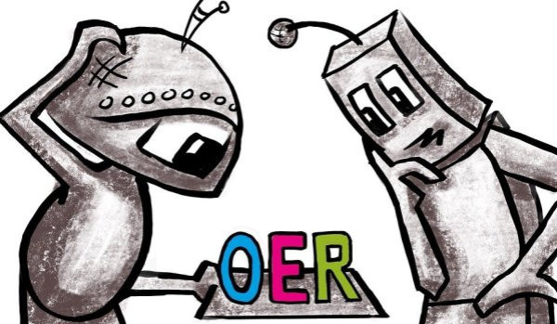
What are OER?
Open Educational Resources (OER) are educational materials of all kinds (e.g. e-books, videos, worksheets, etc.), which are of increasing relevance, especially in the university context.
Educational resources are characterised by the fact that they are freely accessible and are under a free licence. Licenses indicate the use and further distribution of an educational material.
For example, they can be (re)used, modified, republished under a different license.
https://pixabay.com/de/illustrations/roboter-oer-3263267/
Notes:
Basic content slide + presentation boxes variant 1

Slide 5
Benefits for teachers and students

Slide 6
Benefits of Open Educational Resources
OER promotes the Aurora network with a showcase of its members´ pedagogic innovation and talent.
Producing and working with high quality educational material increases the importance of teaching
OER gives students the opportunity to be co-creation partners benefiting themselves and the Aurora network
Re-use of qualitative OER (fragments) saves time and continually improved resources
OER helps making teaching visible (like research)
OER has a clear and simple legal status – it allows free use and re-purposing by others
OER is a cost effective and efficient way to collaboratively create (and improve) high quality resources
OER contributes to providing fair and equal access to knowledge for all
Notes:
Work Package “tree” list

Slide 7
What are the 5 R?
Retain:
the right to make, own and control copies of the content (e.g. download, store and reproduce)
Reuse:
the right to use the content in different contexts (e.g. in a classroom, in a learning group, on a website, in a video)
Revise:
the right to edit, adapt, change or redesign the content (e.g. to translate a content into another language)
Remix:
the right to combine an original or edited content with other open content and create something new from it (e.g. when incorporating images and music into a video)
Redistribute:
the right to share copies of content with others, in the original or in your own revisions (e.g. give a copy to a colleague or publish it online).
Notes:
Páll

Slide 8
Search & Use & Re-mix & Provide

Slide 9
Search & Use & Re-mix & Provide
Provide
Search
Use
Re-mix
Notes:
Páll – start

Slide 10
Licences –
Creative Commons

Slide 11
How do I use OER legally compliant?
OER and the corresponding rights can be recognized by an open license. In most cases this is a Creative Commons (CC) license which is internationally accepted and is an alternative to the ubiquitous regulation to reserve all rights, which strongly limits the further use of educational materials.
Materials that are marked with a CC license may generally be reproduced, used and distributed. The description of the respective license indicates the terms of use:
More information about CC licenses: https://creativecommons.org/licenses/?lang=en
Notes:
Basic content slide + presentation boxes variant 1

Slide 12




How does the licensing model work?
Attribution (BY)
The author, the source and any changes made must always be indicated.
Share Alike (SA)
Attribution of the author and dissemination under the same conditions.
Non-Commerical (NC)
Attribution, non-commercial use only.
No Derivatives (ND)
Attribution, no adaption or modification allowed.

Slide 13




CC BY NC SA
Attribution, NonCommercial, ShareAlike.
CC BY NC ND
Attribution, NonCommercial, NoDerivs.
CC 0
Material can be used without restrictions.
CC Public Domain
Material without copywrite (worldwide).

Slide 14
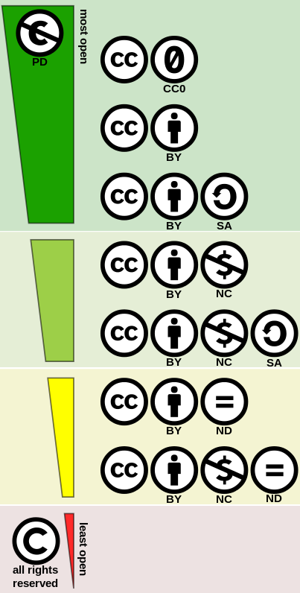
Openess of Creative-Commons Licences
What is not forbidden is allowed
No geographical limitation
The time limit is based on the applicable copyright law
No change from “more open” licenses to more restrictive ones
Unintentional legal violations can occur
CC BY 4.0 Shaddim, Creative Commons license spectrum, URL: https://commons.wikimedia.org/wiki/File:Creative_commons_license_spectrum.svg, picture cropped

Slide 15
Perspectives from teachers and students

Slide 16
OER at UDE / in Germany
OER – University of Duisburg-Essen
Local OER-repository: https://duepublico2.uni-due.de/content/oer/index.xml (German)
Local Information webpage: https://www.uni-due.de/ub/en/eoer.php (English)
Handout: https://duepublico2.uni-due.de/receive/duepublico_mods_00074629 (English)
Learning Management System Moodle “Open UDE”: https://moodle.uni-due.de/course/search.php?search=Open+UDE (German)
Further projects: OER policy & staff training & funding project (2022)
Notes:
Yesterday, our annual E-Learning networking day took place at our university (Duisburg-Essen, Germany). We promoted our OER-policy and accompanying measures e.g. funding program for teachers to provide teaching material as OER (they can request financial resources once up to 3.500 Euro to hire a student assistant for a six-month period in 2022-23).
The library offers online trainings as well as individual consultations to answer questions concerning CC licences, image rights, etc.
The committee for the funding program consists of members from several institutions: Library (lead), Center for Information and Media Services, Center for Higher Education Development and Center for Teacher Training.

Slide 17
OER at UDE / in Germany
Further OER repositories
OER repository of North Rhine Westphalia - https://www.orca.nrw/
OER repository of Baden-Wuerttemberg (ZOERR): https://www.oerbw.de/
OER repository of Lower Saxony (twillo): https://www.twillo.de/oer/web/
OER world map, Germany: https://open-educational-resources.de/karte/
OER repository for teacher education: https://digill.de/
OERhoernchen (“OER squirrel”): https://oerhoernchen.de/
OERinfo: https://open-educational-resources.de/

Slide 18
Students as OER creators
OER takes greater role in teaching
Students are involved in teaching and create OER content (Supporting Staff)
Students look for OER Platforms especially to prepare for exams

Slide 19
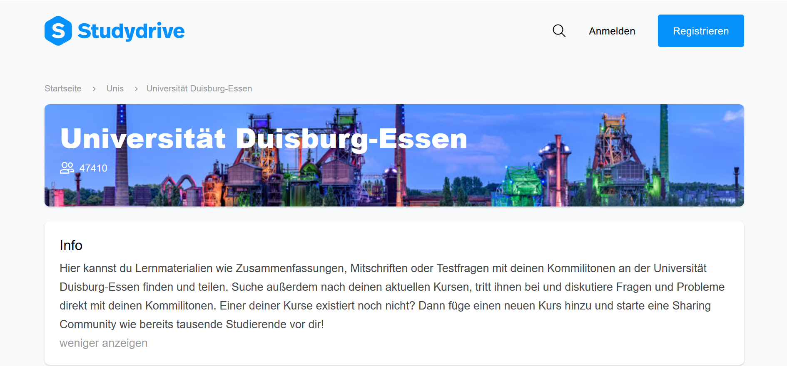
Platforms for OER

Slide 20
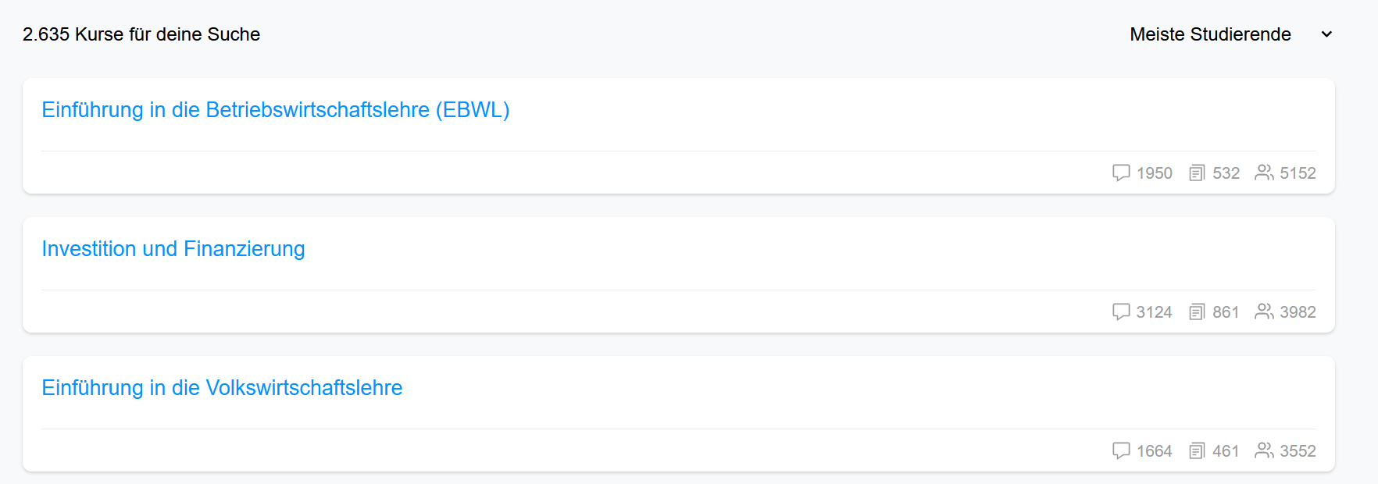
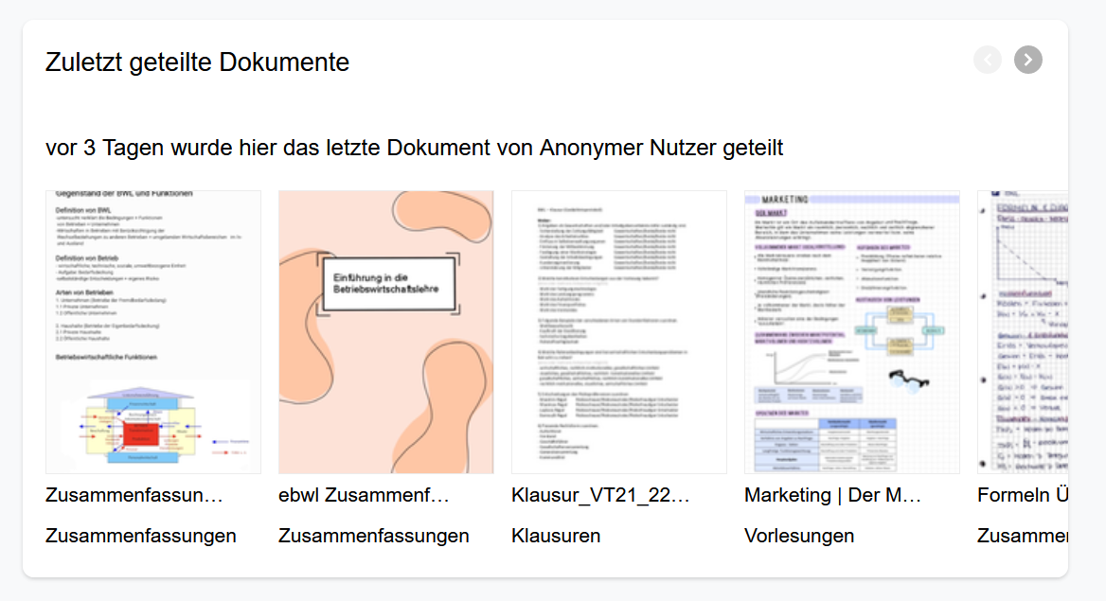

Slide 21
Platforms for OER
5R of OER
Networking with other Students in an anonymous forum:
  Reduction of anxiety
  Information procurement
Creates opportunities for a student body with a broader socioeconomic background
The wide range of platforms on the market makes it hard to find the biggest/most relevant community, a platform provided by the university could be promoted to all students

Slide 22
Questions?
Aylin Kilic: aylin.kilic@stud.uni-due.de
Anke Petschenka
anke.petschenka@uni-due.de
Thank you for Listening!
List of Things
Notes:
Basic content slide

