Slide 1
supporting underrepresented students to build confidence and aspire to study abroad
Dare
Dream
Do
The AURORing Twenties – Design Thinking Jam
Notes:
Underrepresented groups:
Racialised minority students
Cultural/religious groups
Migrants
LGBTQ+
First generation
Low income
Students with Disabilities

Slide 2
Barriers for underrepresented students
I have never even thought about it
I am not confident
Culture – it’s not for me
What will i get out of it?
I can’t afford it
I won’t feel safe there – homophobia, transphobia, racism
I don’t know anything about it
I struggle with anxiety, what support will there be?
It’s too big a step
I don’t know anyone who has done this before
I don’t have any family support
Its not an option on my course

Slide 3
Our solution – The D3 Programme
Collaborative Online International Learning​
Fun activities with international speakers​
Physical challenges – abseiling, mountain climbing etc​
Support with 'life admin'​
Find out about Aurora event/days​
Collaborative social justice projects​
Short residential opportunities​
Short international opportunities​
121 Goal Setting meeting with a mentor
FUN
FLEXIBLE
DIVERSE
Notes:
The key is the mandatory 121 goal setting meeting that helps the participant think about their future and what they want to achieve
Collate all the existing information and support around study abroad and target them to under represented groups
The programme should be delivered by diverse staff/volunteers/ambassadors/Aurora champions

Slide 4
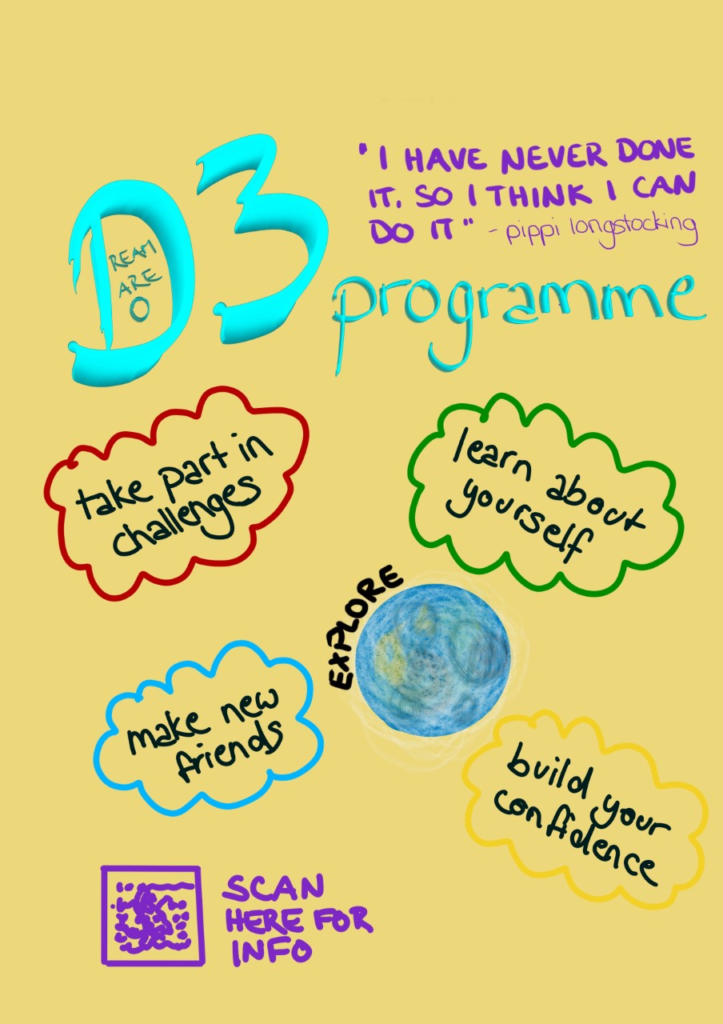
Our prototype poster
The purpose is to:
build confidence and resilience
support underrepresented students to imagine the possibilities
so they are open to the opportunities available to them
It needs to be supported by better promotion and targeting of information about study abroad

Slide 5
What are the benefits?
For students:
Happier students with a better sense of what they want to get out of life and how to achieve it
Students who are more confident and better informed about study abroad opportunities
For universities:
Concrete action towards diversity strategic priorities
Gain insight into what engages and motivates students
Attract more diverse students
Makes study abroad more inclusive and accessible
Be a pioneer and show real leadership in diversity
Reputation

Slide 6
What next?
Pilot this programme in one Aurora institution in Sept 2022
Aim to roll out across Aurora Network 2023-24

