Slide 1
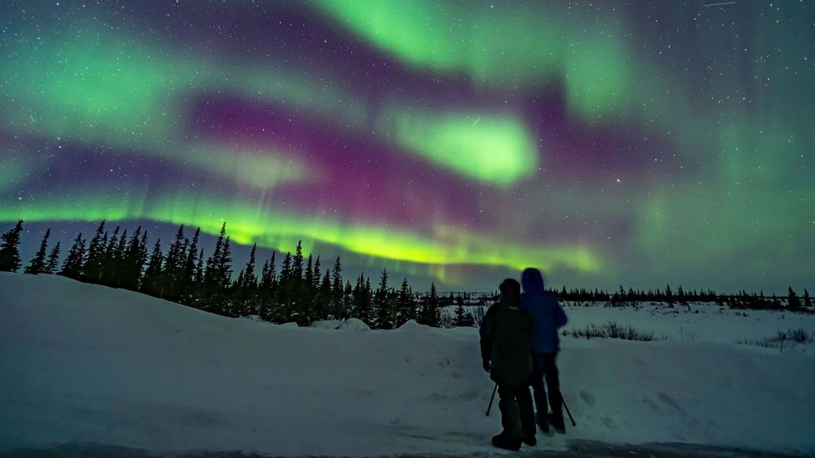
Raising Students’ awareness of Aurora
With the goal of increased application rates for opportunities and increased brand awareness

Slide 2
Core Proposal
There’s a great desparity between universities in awareness of Aurora and the organisation’s opportunities
There is no collective framework for how these opportunities should be advertised or if there should be any regular Aurora events
To combat this we’ve come up with two proposals that work towards raising awareness of the organisation across all universities
These are only the first steps towards raising awareness of Aurora. We will need all of your cooperation to take further steps in that direction

Slide 3
Aurora Week
We came up with the idea that one week of the academic year will be labelled ”Aurora Week”
During this week all universities that are a part of the Aurora cooperation would have a minimum of one event with the core purpose of raising awareness of Aurora
These events do not need to be exclusively focused on Aurora’s mission statement or opportunities, they can be social in nature so long as the Aurora brand is visble throughout
Universities can feel free to be creative in their approach to these events

Slide 4
Aurora Student Council Instagram account
Aurora’s social media presence is lacking
A large portion of students get the vast majority of their information from social media
We have set up an Instagram account for the ASC
Introductions of ASC members
Instagram Takeovers
Advertising opportunities
Documenting Aurora events across all universities (including Aurora Week)

Slide 5
Next steps
Regarding the Instagram account
Introducing Aurora Student Council members
Regarding Aurora Week
Finding a week in the academic calendar that works for universities
We will need administrative help from the General Office as well as university administrators
Regarding the overall promotion of Aurora
Possible Aurora Facebook page – can run Facebook events across all universities
We have considered a TikTok account but it is not a priority at this time. We would like to focus on establishing a presence on one platform first

Slide 6
Wrap up
These ideas, if properly followed through on, will raise awareness of Aurora and our operations across all universities
For this to work we will need increased cooperation, not only between student representatives but the General Office, university administrations and Institutional Coordinators
This is important to
Increase reach
Increase diversity
Provide equal opportunities to students regardless of which Aurora university they come from

