Slide 1
Helping international students to overcome anxiety and depression

Slide 2
Is anxiety and depression during mobility a real problem?
„A moderate prevalence of depression (18.4%), anxiety (23.6%) and stress (34.5%) symptoms in our study population.“ (Ramón-Arbués et al., 2020)

Slide 3
Is anxiety and depression during mobility a real problem?
„A moderate prevalence of depression (18.4%), anxiety (23.6%) and stress (34.5%) symptoms in our study population.“ (Ramón-Arbués et al., 2020)
„Nearly half of the international students had depressive symptoms (47.7%)“ (Jamilah et al., 2021)

Slide 4
The first steps
It will be highly recommended (or obligatory) for all students who are going abroad to complete the standardized psychological test, for example The Penn State Worry Questionnaire or any other.
This questionnaire should be discussed with professionals first!
Work towards NORMALISING the mental health problems.

Slide 5
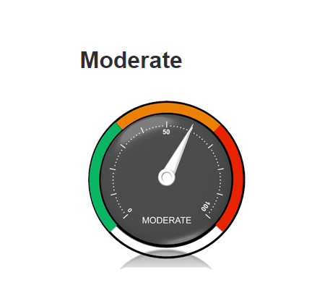
Why is it good for students?
After completing the survey it will be shown that the student might be in low/moderate/severe risk of futute anxiety
There will be information about possibility of participating in Well-being program
It can show students that everyone can go abroad, no matter their mental health problems. They won‘t be alone!

Slide 6
Well-being program
University can provide someone who might help with mental problems online, on the phone or in the city where the student is staying.
This might help to overcome culture shock.

Slide 7
Why is it good for the university?
Universities can collect anonymous data that can show how many students suffer from anxiety and depression.
This data can help universitities to detect whether the mental health might be the issue!
It might reduce the amount of students who interrupt their study abroad.

Slide 8
Story no. 1
Tommy Isaad
High expectations
Tends to suffer from anxiety and depression
He feels alone in the foreign country, depressed because of the other factors (e. g. death in the family) and he has nobody to help him (or he doesn‘t know about the help)
His approach: I WANT TO SURVIVE THIS MOBILITY

Slide 9
Story no. 2
Tommy Isaad
He took the standardized questionnaire before mobility and he now knows he might suffer from anxiety and depression
He knows he can participate in a program to help with his anxiety or depression
His approach: Despite some problems I can have meaningful international experience.
I CAN DO IT!

Slide 10
An example of questionnaire
https://thinkcbt.com/penn-state-worry-questionnaire-pswq
https://docs.google.com/forms/d/e/1FAIpQLSeYuugW1dtSh_SGDLnKUVsFZ6z9l_f5KG7aaH80liKoF9-Qnw/viewform?usp=sf_link

