Slide 1
Time for stories and meaningful international experiences
from Anna-Maria, Antonia, Pauline,
Xennn and Serge

Slide 2
" Most internationals want to connect but locals tend to stay with their homies."

Slide 6
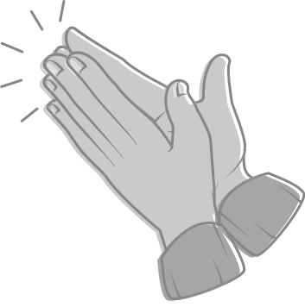
Thanks for your attention!
from Anna-Maria, Antonia, Pauline,
Xennn and Serge

Slide 7
Time for stories and meaningful international experiences
from Anna-Maria, Antonia, Pauline,
Xennn and Serge

