Slide 1
Sustainable Social Enterprises A course for Aurora Universities students
Palacký University in Olomouc, Faculty of Arts,
Department of Economic and Managerial Studies
Principal investigator: Jaroslava Kubátová

Slide 2
The development of the course was supported by an internal Aurora mini-grant within Palacky University
Grant support about EUR 3,400
Motivation of international team members
Literature

Slide 3
The aim of the project
To prepare new social entrepreneurs for the current global environment
Social entrepreneurship is a way of doing business via recognizing social problems and achieving a social change by employing entrepreneurial principles, processes and operations
SDG 1: No Poverty
SDG 8: Decent Work and Economic Growth
SDG 12: Responsible Consumption and Production
SDG 17: Partnership for the Goals

Slide 4
The main outcome of the project
An online course called Sustainable Social Enterprises, that will be offered to all interested students from all Aurora Alliance universities on a regular yearly basis

Slide 5
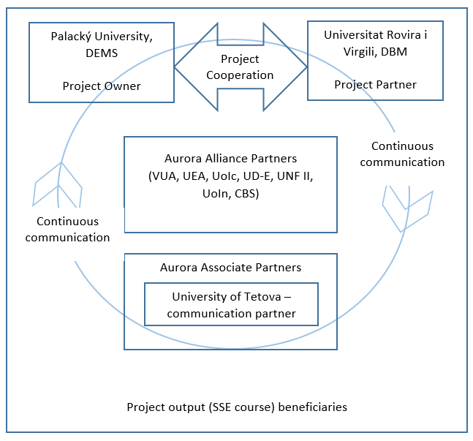
Project consortia structure

Slide 6
The organization of the course
Proposed and taught by academics from the Department of Economic and Managerial Studies, PU
UPOL Moodle support
Zoom lectures
Start: ST 2022
Recommended (but not limited) for bachelor's degree students
Capacity
Optimal 20
Maximal 40

Slide 7
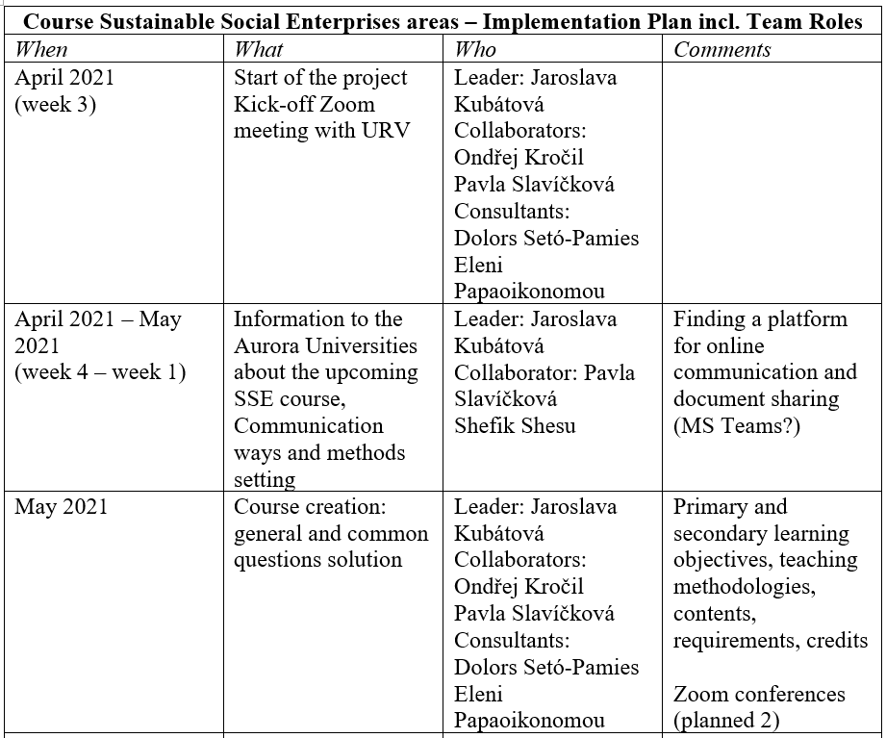
Sometimes things don't go exactly as planned

Slide 8
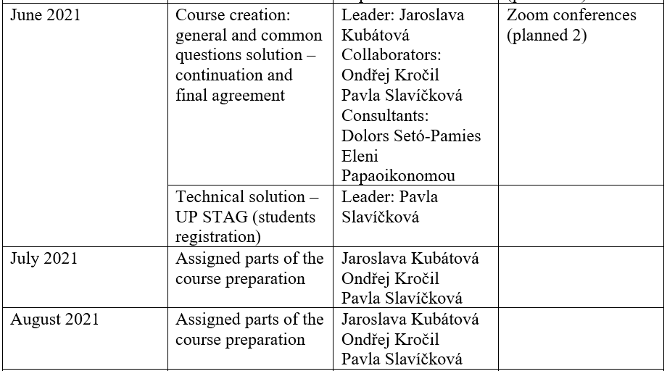

Slide 9
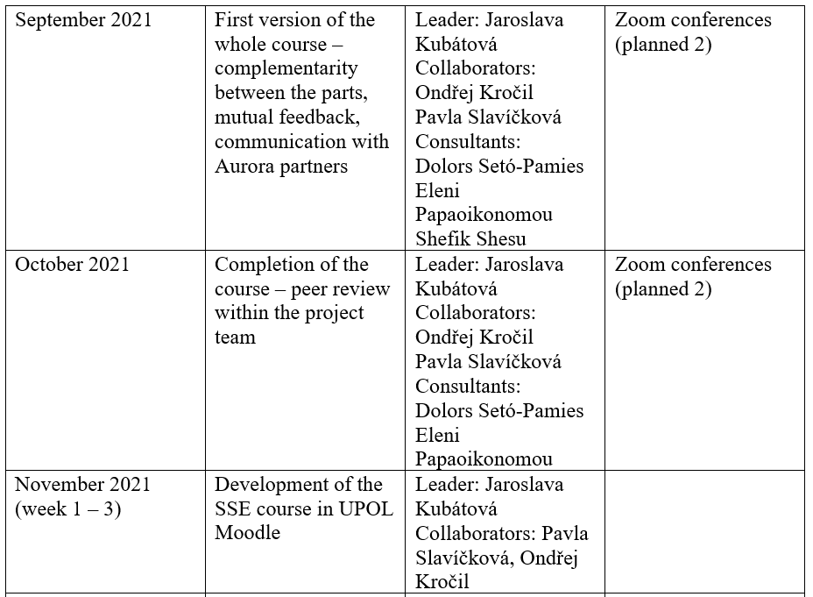

Slide 11
Result
The course is open in ST 2022 and will be offerd regularly in ST
21 UP students
5 international Erasmus students
No Aurora students
There is no way how to officially register/sign up for the course

Slide 12
Thank you for your attention

