Slide 1




Aurora CDS training
University of Tetova
31 March 2022
Notes:
Alt main slide:
There are 2 layered images. To select bottom image and replace it, click on image, select “Picture Format” in ribbon, then “Select Pane” in “Arrange” tab. Select picture in the column on the right (Picture 4), move or right click, then “Change Picture”
Alternate font is used for the title – download the font file “right_click_on_me_and_select_install.otf” to your computer, right click on the downloaded file, select “Install”. After this, font should be available to use in any application (name of the font is Salome).
If you choose to do so, use “Salome” only on titles!

Slide 2


UNITING
UNITING
What is Aurora EUN about?
30.000
Staff
260.000
Students
A partnership of like-minded
research-intensive universities
673.922
Allumni
112
Faculties
813
Research
Groups
Notes:
Basic content slide + presentation boxes variant 1

Slide 3
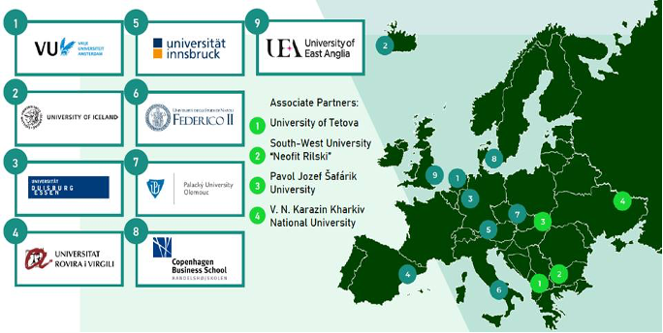
UNITING
Aurora Universities
Notes:
Map with Aurora Associates – pins and numbers are editable, you can add more entries as needed…

Slide 4


Objective
To equip graduates with competencies to address major societal challenges and increase the contribution of our universities to the
Sustainable Development Goals
Notes:
The overall vision of Aurora universities is to maximise the positive social impact of our teaching, learning and training activities.
This is achieved by integrating innovative teaching methods and approaches together into our existing study degree programmes that are designed to better equip our graduates with the necessary skills, competencies and mindset to address societal challenges as social entrepreneurs and innovators in a fast-changing world.
Four Pilot Domains1 and the Sustainable Development Goals (SDGs) provide the thematic bracket for this, which also reflects the research strengths of the Aurora universities.
The overall vision of Aurora is to equip graduates with competencies to address major societal challenges and increase the contribution of our universities to the Sustainable Development Goals. We are in the process of co-creating our methods and developing our shared infrastructures and frameworks and as we progress.
Aurora aims at building a different kind of inclusive university whose graduates have the mindset and skills to tackle the most challenging issues that our societies face, focussing in its first phase on social entrepreneurship and innovation. In the session of the CDS programme, we will share some frameworks and tools that we are developing to help universities achieve those goals.

Slide 5

UNITING
Learning for societal impact
Engaging communities
The Aurora Activity Programme
Shared priorities
Sustainability pioneers
Research &
Innovation for
Societal impact
Notes:
The activity programme set out in our bid is the shared ambition and endeavour of our students, academics, university leaders, and administrators and reflects the Aurora vision of a European University in four pillars:
Aurora Learning for Societal Impact aims to equip students and graduates with the skills and mindset needed for them to take responsibility and initiative in addressing societal challenges.
Aurora Engaging Communities is about engagement with our diverse stakeholders at local, regional, national, European, and global level, as well as with our students and academics.
Aurora Sustainability Pioneers aims to make our universities as sustainable as possible across all their endeavours.
Aurora Research and Innovation for Societal Impact aims to deepen and expand our cooperation as research-intensive universities dedicated to societal impact and engagement within the framework of the SDGs.

Slide 6
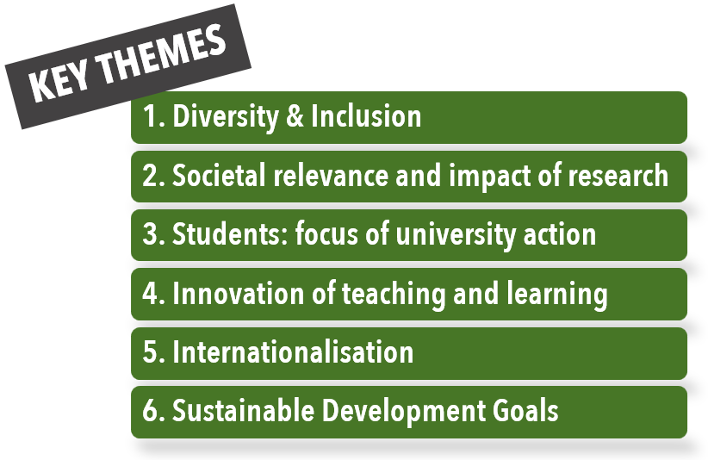
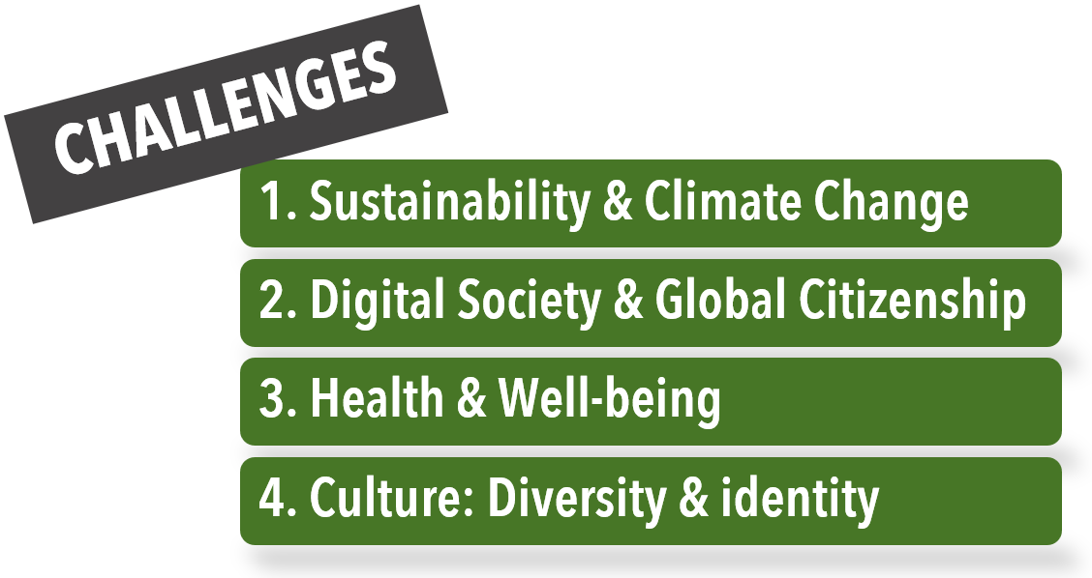
Pilot Collaboration Areas

Slide 7

Aurora Engaging Communities
Work package 4
Aurora Capacity Development Support Programme (CDS)
36 months: Nov 2020-Nov 2023
Lead: Tereza Kalouskova, UP
Co-lead: Sabina Di Prima, VU
Notes:
The overall vision of Aurora universities is to maximise the positive social impact of our teaching, learning and training activities. This is achieved by integrating innovative teaching methods and approaches together into our existing study degree programmes that are designed to better equip our graduates with the necessary skills, competencies and mindset to address societal challenges as social entrepreneurs and innovators in a fast-changing world. Four Pilot Domains1 and the Sustainable Development Goals (SDGs) provide the thematic bracket for this, which also reflects the research strengths of the Aurora universities. Another important factor is the development of joint courses and degree programmes in response to the major societal challenges of our time. This process of upgrading our teaching, learning and training activities to achieve the overall vision of Aurora Universities is referred to as the ‘Aurorisation’ of our courses and programmes.

Slide 8
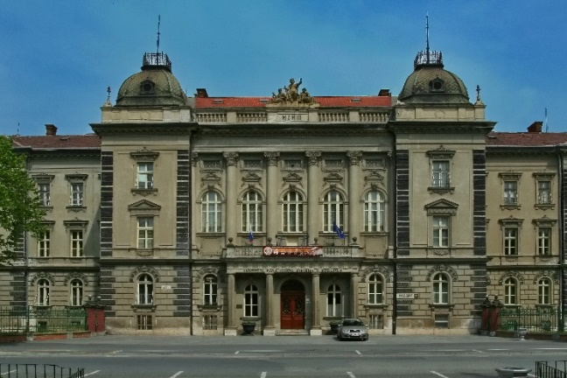
Aurora CDS University Network
Pavol Jozef Šafárik University in Košice
State University of Tetova
4 Associate Partner Universities
+ 30 more universities - CDS University Network
South-West University ‘Neofit Rilski’
Notes:
The main objective of ‘Aurorisation’ is to enhance teaching and learning using one or more of the methods developed or promoted by Aurora to foster students´ social innovation competences and mindset or in other words to make them innovative and sustainable “change makers” In its transformational process, Aurora embraces different values and educational perspectives and “Aurorisation” thus encompasses a variety of pedagogical methods and approaches. Each academic participating in Aurora should reflect on the overarching goals of the three-year programme funded by the European Commission as part of the European Universities Initiative and determine which method or approach, or combination of methods and approaches, would bring the most added value to their courses and for their students. As a reminder, the following are the overarching goals: ü Equip a diverse student population with the skills and mindset to make them social entrepreneurs and innovators, willing and able to tackle the major challenges of our societies ü Make collaboration with external stakeholders and students regular practice in education, research and outreach – at local, national, European and global levels ü Lead by example and inspire others as pioneers in sustainability, reducing the footprint of our individual and collective activities and making substantial contributions to addressing the Sustainable Development Goals (SDG).
No matter which method or approach is chosen, all those listed below are characterised by the fact that they put the learners at the centre. In doing so, however, they also make the teachers/academics coaches for the actual learning process. In addition, the chosen approach/method must be in line with the intended learning outcomes, the intended generic/academic competences, the contents, but also with the framework conditions, or at least with the strengths of the teachers/academics, in the sense of constructive alignment:

Slide 9





About CDS
Chairs
Task 4.1
Co-creation
Strengthening the capacity for academic excellence and societal relevance in Central and Eastern Europe and Neighbouring Countries
Goals
30 target universities have been reached about possibilities of strengthening capacity
5 Aurora deliverables have been adapted to local HE contexts
3 joint projects developed
Task 4.2 Academic Collaboration Platform
Task 4.3 Social Entrepreneurship & Innovation
Task 4.4 Aurora Capacity Development Support programme
Task 4.5 Aurora Institute

Slide 10









CDS Participants
Associate Partner Universities
Aurora Member Universities
CDS Network members
 | South-West University “Neofit Rilski” Blagoevgrad, Bulgaria
 | Pavol Jozef Šafárik University in Košice Košice, Slovakia
 | V. N. Karazin Kharkiv National University Kharkiv, Ukraine
 | University of Tetova Tetova, Northern Macedonia
 | Universität Duisburg-Essen, Germany
 | University of Innsbruck, Austria
 | University Federico Secundo in Napoli, Italy
 | Copenhagen Business School, Denmark
 | Babeș-Bolyai University, Romania
 | University of Tirana, Albania
 | Ukrainian Catholic University, Ukraine
 | State University of Medicine and Pharmacy "Nicolae Testemițanu" Molodova
 | Bar-Ilan University, Israel

Slide 11
3 CDS projects
5 Deliverables adapted to CDS partners’ local contexts
2021
31st March Virtual training ‘Transforming teaching through soft skills, social engagement and virtual exchange competences’
5th -6th October Hybrid training at South-West University ‘Neofit Rilski’, Bulgaria: ‘Community Service Learning and COIL’
8th December Hybrid training at Palacky University Olomouc, Czech Republic: ‘Competence Framework Training’
2022
30th-31st March Hybrid training at University of Tetovo, North Macedonia: ‘Social Entrepreneurship and Diversity and Inclusion’
June Pavol Jofef Šafárik University in Košice –mentoring & skill sharpening for teachers, modernisation of teaching methods/digitalisation

Slide 12
3 CDS projects
3 CDS Projects
March 2021 UP Aurora mini-grant scheme: 17 education & research projects
https://aurora.upol.cz/aurora-mini-grants-list-of-awarded-mini-grants/
March 2022 VU Aurora mini-grant scheme: First grant to UT
Summer 2022 UP Aurora Summer School – together with V. N. Karazin Kharkiv National University

Slide 13



Learning &
Engaging communities
for Societal Impact
    https://aurora.upol.cz
    https://aurora-universities.eu
CDS Training event
South-West University “Neofit Rilski”
October 5-6 2021
Notes:
Alt main slide:
There are 2 layered images. To select bottom image and replace it, click on image, select “Picture Format” in ribbon, then “Select Pane” in “Arrange” tab. Select picture in the column on the right (Picture 4), move or right click, then “Change Picture”
Alternate font is used for the title – download the font file “right_click_on_me_and_select_install.otf” to your computer, right click on the downloaded file, select “Install”. After this, font should be available to use in any application (name of the font is Salome).
If you choose to do so, use “Salome” only on titles!
The overall vision of Aurora universities is to maximise the positive social impact of our teaching, learning and training activities. This is achieved by integrating innovative teaching methods and approaches together into our existing study degree programmes that are designed to better equip our graduates with the necessary skills, competencies and mindset to address societal challenges as social entrepreneurs and innovators in a fast-changing world. Four Pilot Domains1 and the Sustainable Development Goals (SDGs) provide the thematic bracket for this, which also reflects the research strengths of the Aurora universities.

