Slide 1
Diversity and Inclusion Dimensions of Diversity and Practical Strategies
AURORA-Training Event
Tetova, 01-04-2022
Ruard Ganzevoort, Vrije Universiteit Amsterdam
Chief Diversity Officer, Dean Faculty of Religion and Theology

Slide 2
Why diversity policies?
Think of two reasons why diversity policies are important for your institution
Then think of one strong argument against these two reasons
SHARING

Slide 3
Why diversity policies?
We don’t want to miss out on talent
We aim for broader academic quality
We aim for maximum impact on society
We want to make differences fruitful
Inclusion is more than tolerance or ships passing by in the night
Dialogue between perspectives facilitates learning and innovation
We want to cope better with risks of conflict
Strong identities clas easily
Polarised societies need better communication
We want to reflect more critically on ourselves
Increased diversity challenges vested interests and assumptions
Institutional structures are fraught with injustices

Slide 4
Policy dimensions
Representation
Eq(al)ity
Ideology

Slide 5
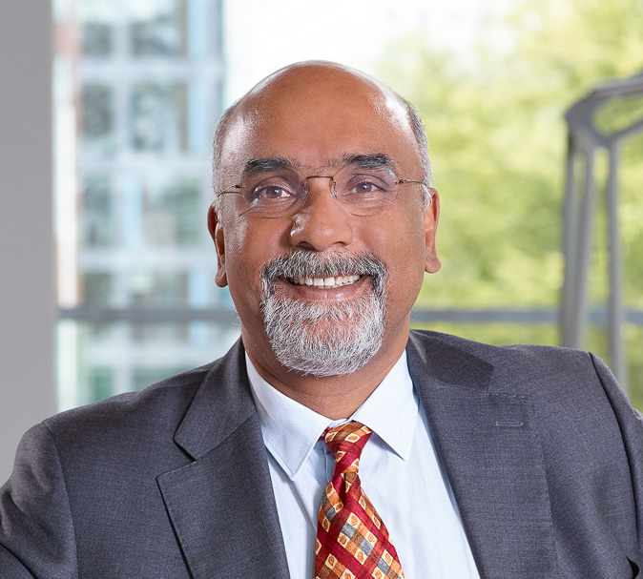
Policy dimensions: Representation
Visibility
Role models on key positions
Checking representations in communication
Voice
Nothing about us – without us
Breaking paternalist patterns
Facilitate diversity networks for specific groups

Slide 6
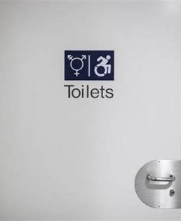
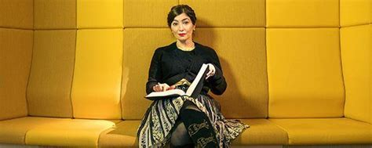
Policy dimensions: Equ(al)ity
Gender inclusive restrooms
First generation students
Language policies for international students
Learning / working environment accounting for neurodiversity
Gender pay gap
Career programs for disadadvantaged scholars

Slide 7
Policy dimensions: ideology
Facilitate critical dialogues about the underlying culture:
Black Lives Matter
Decolonisation
East meets West
Academic publishing and epistemological imperialism
Me Too and male dominance

Slide 8
How does your university / department score on Representation, Equ(al)ity, and Ideology?
What can you do to improve the balance?
SHARING

Slide 9
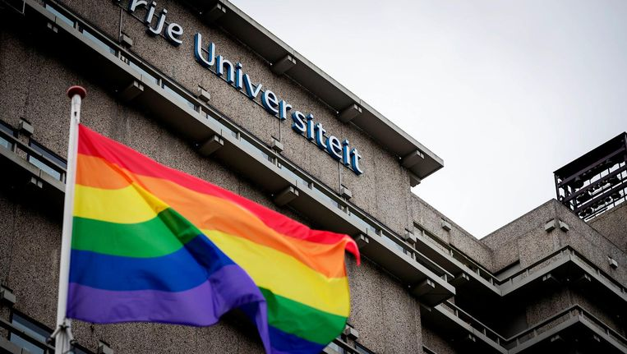
Dimensions of diversity: target areas
Gender
Male / female ratio for different staff levels
Equality in payment, positions, facilities
Effects of social and cultural factors on career paths (COVID-19!)
LGBT+
Inclusion among students and staff
Optional pronouns in digital systems and in class
Gender-inclusive restrooms
Visibility of acceptance

Slide 10
Dimensions of diversity: target areas
Physical and mental capacities
Accessibility in campus facilities and built environment
Facilitate jobs for people with additional support needs
Account for neurodiversity and people with chronic illnesses
Useability of digital environment

Slide 12
Dimensions of diversity: target areas
Physical and mental capacities
Accessibility in campus facilities and built environment
Facilitate jobs for people with additional support needs
Account for neurodiversity and people with chronic illnesses
Useability of digital environment
Cultural-ethnic and religious diversity
Check disproportionate student subscription and success
Facilitate dialogues between different communities
Take active measures to diversify staff

Slide 13
Action Plan Increasing Staff Diversity
2020 | Non-western | Family migrationbackground
Students | 22 % | 14,5 %
Academic Staff | 8 % | 1,4 %
Recruitment: reducing bias in process, language, criteria
Culture: inclusive leadership, teamspirit, relationships
Career paths: criteria for promotion, scouting
Academic staff: changes needed on all levels (student – professor)
Non-academic staff: check for diversity in especially higher ranks

Slide 14
Monitoring Diversity, Equ(al)ity, and Inclusion
How can you measure improvement on DEI
Purposes for registration of diversity dimensions
Privacy versus policy
Inclusive by design
Which dimensions of diversity are measured or forgotten?
Does registration undermine inclusion by perpetuating differences?
Monitoring DEI on institutional / team level
Monitoring inclusion strategies rather than diversity outcomes?
DILEMMA

Slide 15
Organizing diversity policies
Three actors are needed:
Institutional support by executive board
Bottom-up initiatives and signals, awareness raising
Expertise collected and shared by Diversity Office

Slide 16
DO@VU
Chief Diversity Officer (what’s in a name)
DO Education
DO Human Resources and Communication
DO Campus and Community
DO Research
Student Diversity Officers
Decentralized Diversity Officers
Diversity networks and ambassadors

Slide 17
Which ideas from today can you use in your own context?
Which best practices from your own context can you share?
What can we do together to improve DEI?
SHARING

