Slide 1
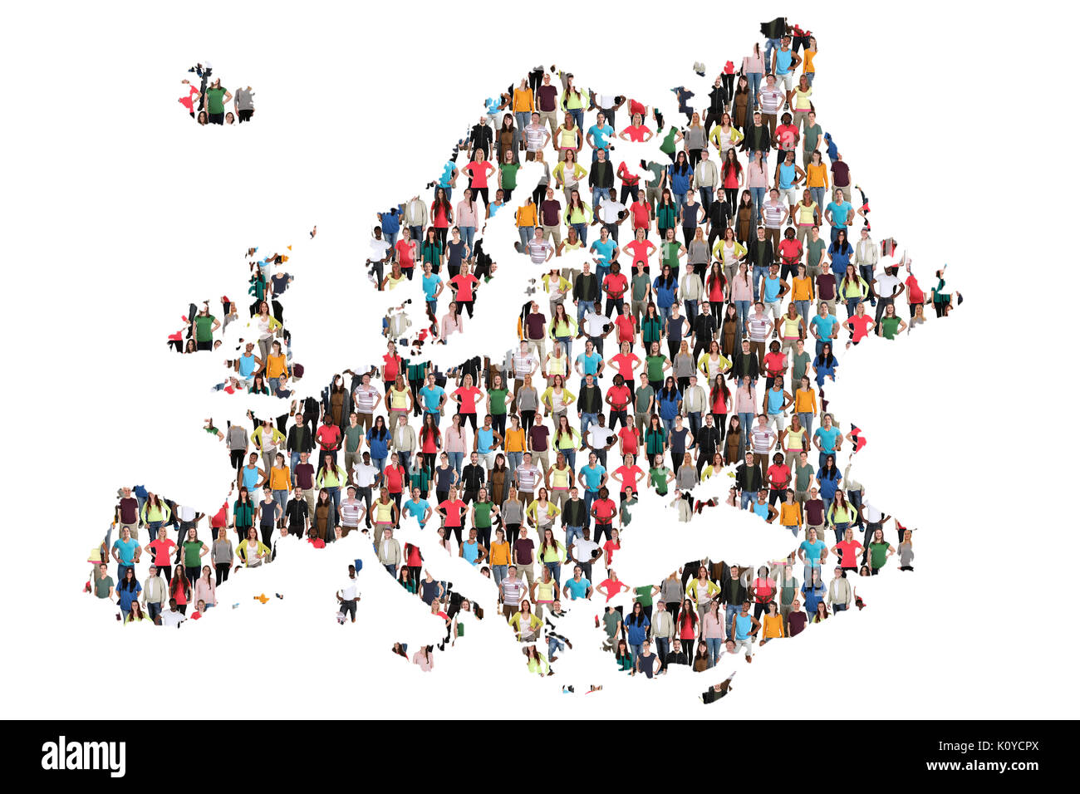
Diversity and Inclusion Key conceps and fundamental debates
AURORA-Training Event
Tetova, 01-04-2022
Ruard Ganzevoort, Vrije Universiteit Amsterdam
Chief Diversity Officer, Dean Faculty of Religion and Theology

Slide 2
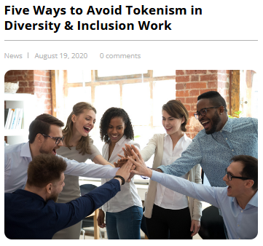
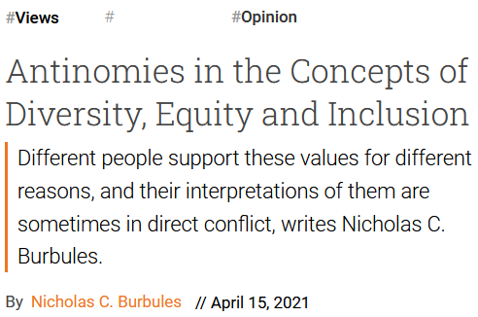
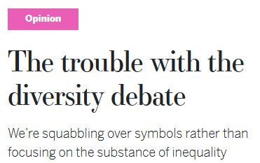
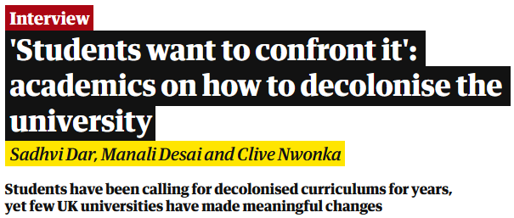

Slide 3
How can we have a meaningful conversation about diversity and develop practical policies?

Slide 4
What is diversity anyway?
Resource
Risk
Reality
The degree to which characteristics differ within a group
Diversity is not a qualification of certain individuals or minority groups

Slide 5
Diversity and differences
Personal differences
Gender
Age
Sexual orientation
Physical capacities (and ‘handicaps’)
Mental capacities (‘neurodiversity’) and personality
Contextual differences
Socio-economic background
Social and cultural capital
Cultural, ethnic and linguistic background
Religious identity and political preferences

Slide 6
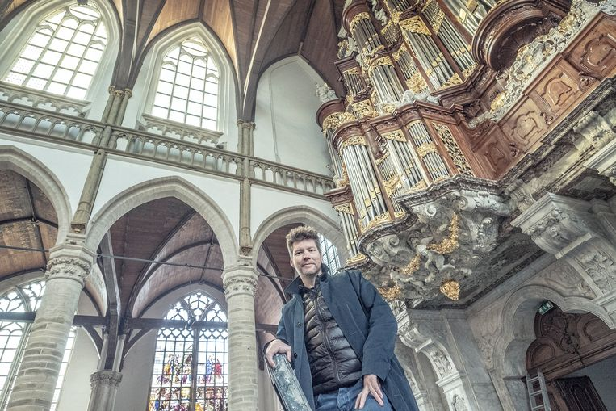
Handicap, disability, or diversity
Jacob Lekkerkerker seven-fingered
concerto organ player
What is the norm by which we are measured?
Sign language: adaptation or a culture of its own?
What is the standard eye level in our buildings?
Is the person disabled, or is the institution dysfunctional?

Slide 7
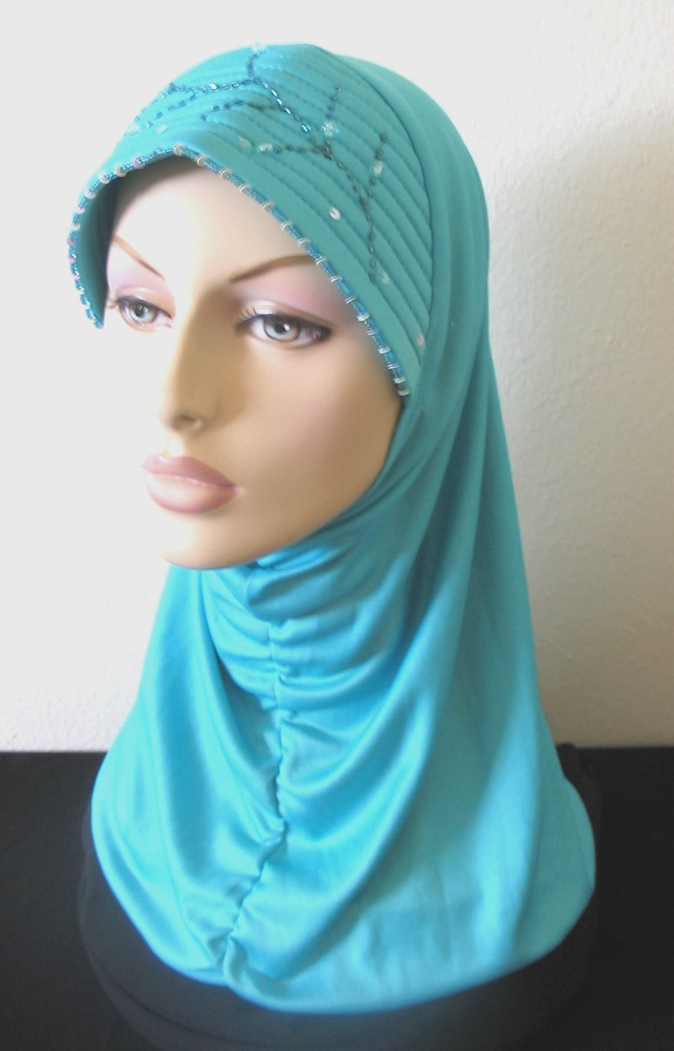
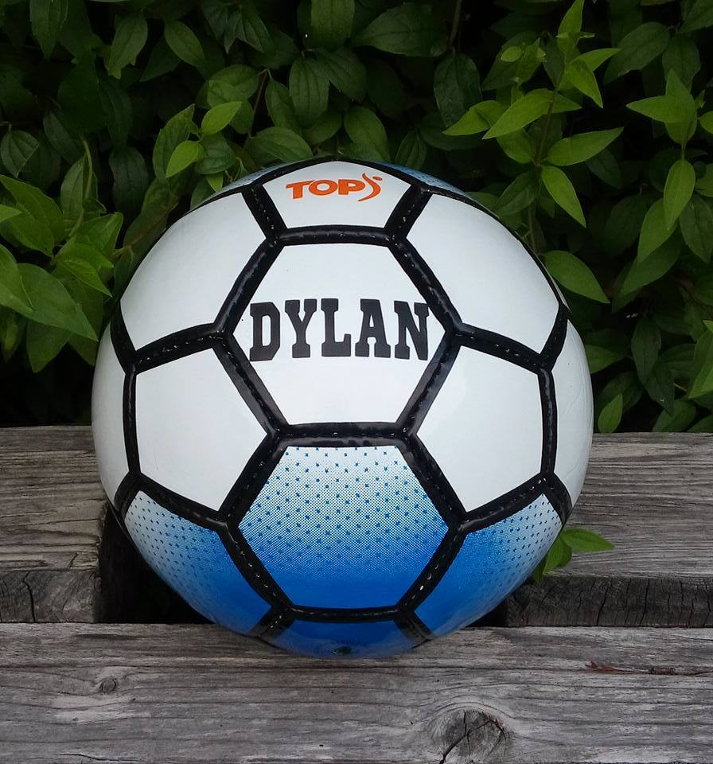
Fariha – student Psychology
Dylan – student Law
Parents from Pakistan
Moved to Amsterdam just before Fariha was born
Father is dentist, mother is lawyer
Secondary school at elite school, supported by individual tutoring
Devout Muslim (wears hijab)
Every summer family vacation to Pakistan
Raised in working-class neighbourhood in traditional Dutch family
Father is unemployed metal worker, mother works as bus driver
After vocational training progressed to university
Plays soccer in first team of his club
(closeted) gay
Spends summer with friends at music festivals

Slide 8
Identity
Every individual is an intersection of supportive and limiting forces
Dimensions are foregrounded or downplayed depending on social valuation
Identity is narratively navigating the storyscapes of our environment

Slide 9
Grammars of Identity*
Orientalizing
Segmentation
Encompassment
“They are always so …”
“Well, you Dutch / American / Turkish people…”
“Women are just more emotional”
“But I must say they stronger family ties”
“Italianen are different from us, but at least they are still Europeans”
“I don’t see color or gender. I only see a fellow human”
“I feel closer to Christians from Africa than to Muslims from my own country”
“Homosexuality is western decadence and a threat to our family values”
“As long as we all comply with European values and universal human rights, …”
“You can hardly notice he is a transgender”
“You can’t expect us to adapt the building to every handicapped person”
“Women can be successful academics if they are willing to work as hard as us men”
* Gerd Baumann (2005) Grammars of Identity / Alterity. New York: Berghahn

Slide 10
Valuing differences
Some differences are appreciated more positively by social contexts and policy makers than others.
Some differences are more objectively observable than others.
Some differences are ‘natural’ / ‘birth-given’ and others are ‘chosen’.
Some differences are individual and others are collective.
Which differences do we value positively / negatively?
The importance of certain differences is the outcome of political action.
DILEMMA

Slide 11
Key concepts (1)
Diversity: acknowledge differences
Equality: work towards equal rights
Equity: work towards equal outcomes, acknowledging different starting positions
Inclusion: work towards removing the obstacles

Slide 12
Key concepts (2)
Superdiversity
Minority-majority
Discrimination
Systemic / institutional racism / sexism / ableism / …
Minority Stress
Positive discrimination
Intersectionality
Privilege

Slide 13
(dis)advantages
Advantages
which three aspects of your biography have made your life easier and more successful?
Disadvantages
which three aspects of your biography have made your life more complicated and less successful?
Contexts
How does your unique configuration play out in different contexts?
SHARING

Slide 14
Differentiation and Discrimination
Categorization and differentiation of our social environment is essential for our human existence
Ingroup-outgroup dynamics is fundamental social psychology*
‘Bonding capital’ serves group coherence and protection
‘Bridging capital’ serves connection with others and innovation
* Kristy Jia Jin Lee, Gianluca Esposito & Peipei Setoh (2018) Preschoolers favor their ingroup
when resources are limited. Frontiers in Psychology 9, 1752. doi: 10.3389/fpsyg.2018.01752

Slide 15
Class, identity, woke
In the past years, more attention is given to issues of personal and cultural identity, including sexuality and gender.
To what extent does that undermine the structural disadvantages related to for example social economic class differences?
How do we balance the “identity-driven” diversity activism with the “structure-driven” diversity activism?
DILEMMA

